Slide 1

API NOMIS
&
The National Centralized Repository for Alzheimer’s Disease and Related Dementias (NCRAD)
Biofluids Collection Training Slides
Notes:
Hello, thank you all for being here! Today we are going to go over sample collection, processing, and shipping for the API NOMIS protocol.

Slide 2
Contact Information
Questions?
Please contact NCRAD Coordinators at:
  Phone: 1-800-526-2839 or 1-317-278-1980
  E-mail: alzstudy@iu.edu or iharms@iu.edu
  Website: www.ncrad.org
Notes:
If you ever have any questions, please contact NCRAD. The general NCRAD phone and email are listed first. My personal work contact information is listed second. Our website is also a great place to look if you have any questions. I’d also like to note that our website underwent a major change recently, so it may look different than what you are used it. We will preview it together today.

Slide 3
Training Overview
Specimen Collection Schedule
Kit Request Module
Specimen Labels
Handling/Processing Study Specimens
Sample Shipping
NCRAD Website
Questions

Slide 4
Specimen Collection Schedule
Timepoint | Collection
 | Plasma | Buffy Coat
Baseline | X | X
Follow-Up | X | X
Notes:
Here is an overview of the specimen collection schedule for all cycles in API NOMIS. At each cycle, you will collect plasma and buffy coat. We will go over sample collection in more detail later.

Slide 5
Kit Request Module
www.kits.iu.edu/api_nomis
Notes:
To order supplies for subject visits, you can use the kit request module at this link. Be aware of the underscore

Slide 6
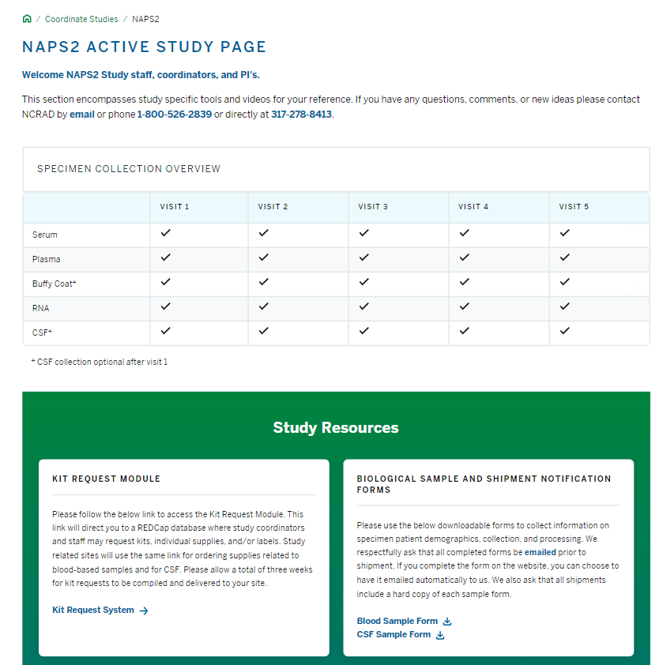
Notes:
On your API NOMIS active study page, you can find the link for the Kit Request Module directly below the Specimen Collection Overview.

Slide 7
Kit Request Module
Kits and individual supplies available to order:
  Blood Collection Kit
  Individual Supplies
Notes:
Within the kit request module, you can order kits and individual supplies. These include:

Slide 8
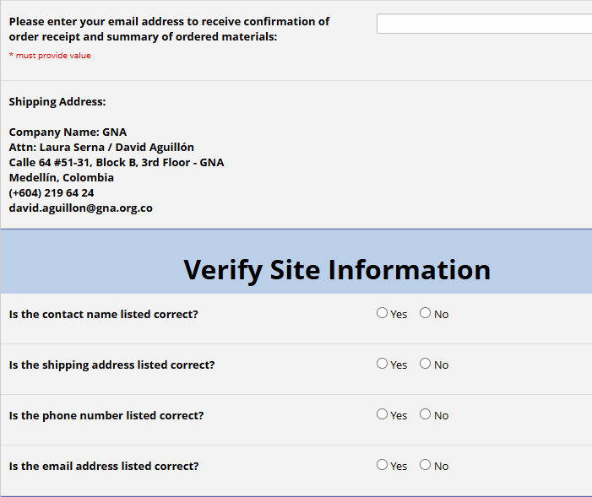
Kit Request Module
Enter your email address.
The coordinator name and contact information will populate.
Verify that this information is correct.
Notes:
This is what you will see when you open the kit request module. Please choose your site from the dropdown list. This will cause the coordinator name and contact information to populate. Please verify that the contact and shipping information is correct.

Slide 9
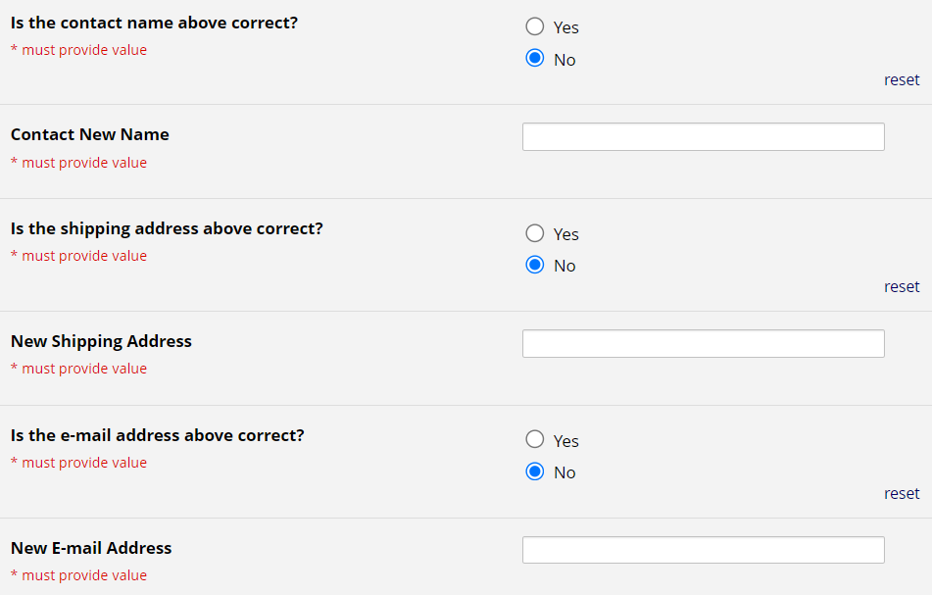
Kit Request Module
If any of the information is incorrect, please indicate so by selecting “No.”
A text box will appear.
Provide the correct information here.
Notes:
If any of the information is incorrect, please indicate so by selecting “No.” This will cause a text box to appear where you can provide the correct information.

Slide 10
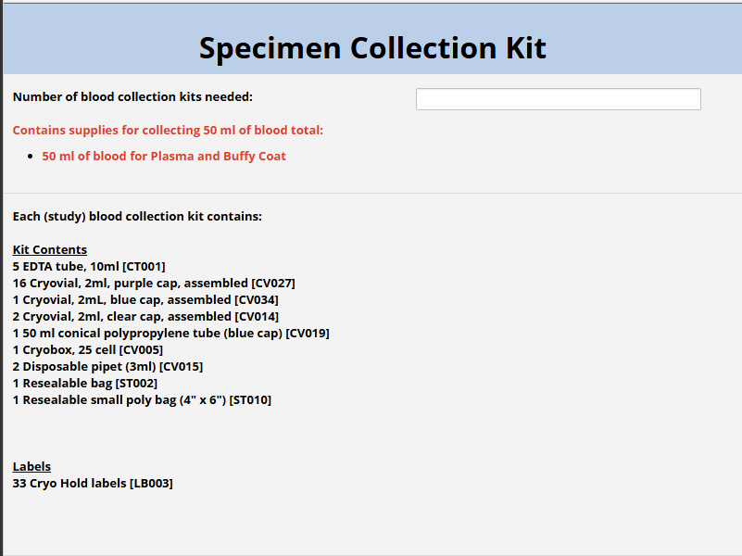
Kit Request Module: Kit Selection
Indicate the quantity needed of each kit
**Note: You can order blood collection and supplemental kits in the same kit request**
Notes:
Scrolling down in the kit request module, you will indicate the quantity needed of each kit. For every kit ordered, we will automatically register it as cycle 1, but you will use it for whichever cycle you need. Once you indicate that you would like a certain type of kit, the components of the chosen kit will appear at the bottom of the screen. I’d like to note that you can order more than one type of kit in a single request.

Slide 11
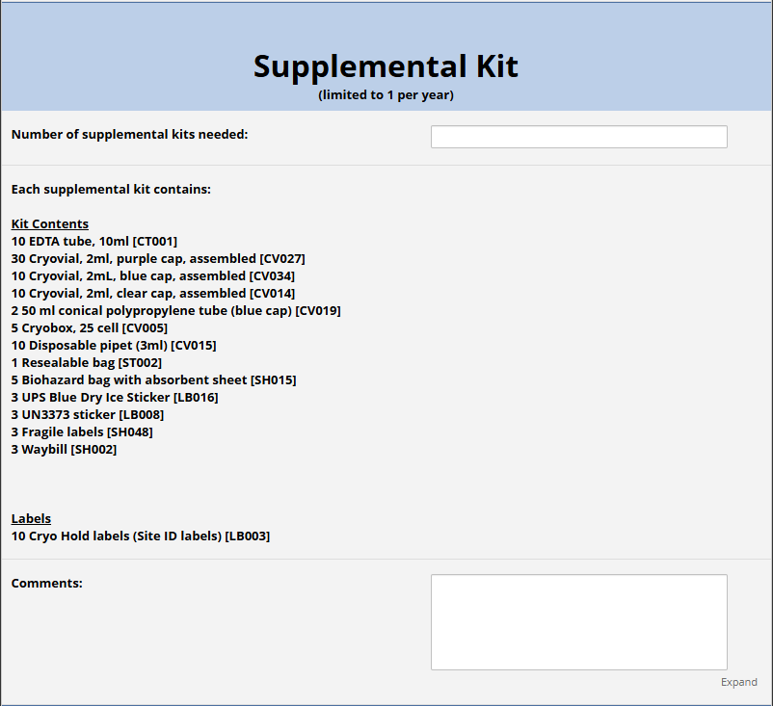
Kit Request Module: Kit Selection
If individual supplies are needed, select yes, select the supplies needed, and specify quantities below.
Click “Submit” to turn in your request.
The IU staff will notify you that your request has been received and address any issues.
Notes:
If individual supplies are needed, select yes, select the supplies needed, and specify quantities below. When you have reviewed your order, click submit at the bottom of the form to turn in your request. You will receive an automated email saying that your request was received. If we have any questions about your order, we will reach out to you directly.

Slide 12
Kit Request Module
Each site is responsible for ordering kits and maintaining supplies on site for their scheduled participants.
To order kits, sites will use the Indiana University online kit ordering module: www.kits.iu.edu/api_nomis
Allow around 3 weeks for your order to be processed and shipped.
Notes:
Each site is responsible for ordering kits and maintaining supplies on site for their scheduled participants. The link to order kits is listed again for you here. Please allow around 3 weeks for your order to be processed and shipped.

Slide 13
Specimen Labels
Notes:
Now we are going to move on to Specimen Labels.

Slide 14
Specimen Labels
Label type summary:
  Kit Number Labels
  API NOMIS ID Labels
  Collection Tube Labels
  Aliquot Tube Labels
    Differ by specimen type
All labels are provided in the kits
Notes:
There are three types of labels to go over: Kit number labels, API ID labels, and collection and aliquot tube labels, which differ by specimen type. All labels that you will need are provided in the kits.

Slide 15
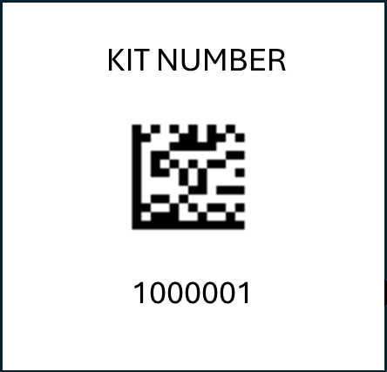
Specimen Labels: Kit Number Labels
Used to track patient samples and provide quality assurance
Will be placed on:
  Blood Sample and Shipment Notification Forms
  Outside of cryobox(es) that houses aliquot tubes during storage and shipment
Notes:
Let’s first talk about the kit number labels. These are used to track patient samples and provide quality assurance. Kit number labels will be place on the Sample and Shipment Notification Form and on the outside of cryobox(es) that houses aliquot tubes during storage and shipment. Please note that CSF samples will have a different kit number than blood samples.

Slide 16
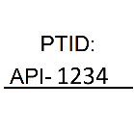
Specimen Labels: API NOMIS ID Labels
Subjects will be identified by their API ID
Sites will be responsible for handwriting the IDs on the provided labels
  Fill in labels prior to adhering to tubes
  Must use fine-point marker
Labels will be placed on all collection tubes:
  EDTA Lavender Top Tube (5 x 10 ml)
Notes:
Next let’s talk about API ID labels. Subjects will be identified by their API ID. This is what these labels look like- with a blank space to write your site number and another space to write the subject’s API ID. Sites will be responsible for handwriting the IDs on the provided labels. Please fill in the labels prior to adhering them to the tubes, and do so using a fine point marker. These labels will be place on all collection tubes: serum red top, your EDTA lavender top, and your PAXGene tubes.

Slide 17

Collection Tube Labels
API NOMIS
COLLECT
Kit: 1000001
1000000124
WBLD
EDTA10
10000. uL
Study Name
Collection Tube Designation
Kit # (unique to the participant and visit)
Specimen Barcode (unique for each tube)
Sample Type
Collection Container
Quantity
Labels to be placed on ALL collection tubes

Slide 18
Aliquot Tube Labels
API NOMIS
ALIQUOT
Kit: 1000001
1000000124
PLA
EDTA10
1500.00 uL
Study Name
Aliquot Tube Designation
Kit # (unique to the participant and visit)
Specimen Barcode (unique for each tube)
Sample Type
Collection Container
Quantity
Labels to be placed on ALL aliquot tubes

Slide 19
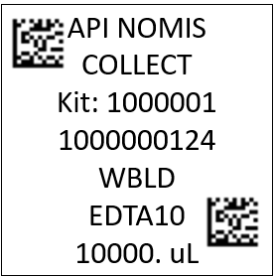
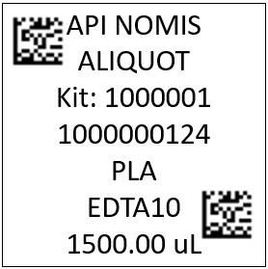
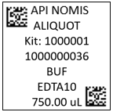
Collection and Aliquot Tube Labels
Every combination of Sample Type and Collection Tube that you may encounter
Look to the Sample Type & Collection Tube lines to determine what tube / cryovial the label should be placed on

Slide 20
Specimen Type & Collection Tube Guide
SPECIMEN TYPE ABBREVIATIONS
WBLD - Whole Blood
PLA - Plasma
BUF - Buffy Coat
COLLECTION TUBE ABBREVIATIONS
EDTA10 10mL EDTA Lavender-Top Tube
TM

Slide 21

Specimen Labels: Blood Collection Tubes
Please ensure the left-hand barcode is near the cap
EDTA collection tubes will have two labels:
  Collection Tube Label
  Site and NAPS2 ID Label
Label 1:
Label 2:
10mL Serum Tube
Notes:
Now let’s go over the labels that will go on your blood collection tubes. These are your EDTA tubes. They will all have two labels: the collection tube label, and the API NOMIS ID label. These are shown here..
Here is an image showing how to adhere the labels to your collection tubes. The Collection tube label should be placed at the top, horizontally, with the left-hand barcode closest to the cap. The API NOMIS ID label should go on the bottom of the tube, also horizontally. Note that the API NOMIS ID label is filled out prior to being placed on the tubes.

Slide 22
Specimen Labels: Blood Collection Tubes
The labels on your blood collection tubes should say COLLECT and they should all have specimen type =
WBLD
10mL EDTA Tube
Notes:
The specimen type indicated on the labels should be WBLD for whole blood on all of your collection tube labels.

Slide 23
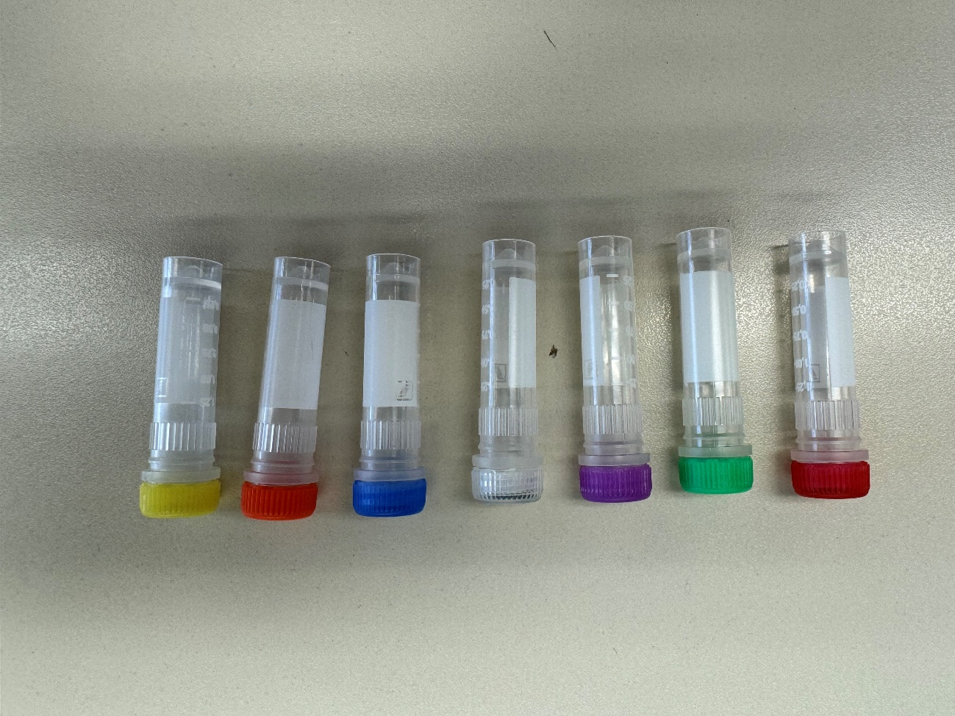
Specimen Labels: Aliquot Tubes
All aliquot tubes will have only one label:
  Aliquot Tube Label
Cap Color | Sample Type
Lavender Cap | 1.5ml Plasma aliquots
Clear Cap | Buffy Coat
Blue Cap | Residual (plasma)
Notes:
Now let’s go over labeling your aliquot tubes. These are the 2ml cryovials with either a red, green, lavender, clear, blue, orange, or yellow cap. These aliquot tubes will only have one label: the aliquot tube label. An example of an aliquot tube label is shown here. This is a 1500uL plasma aliquot tube label that would be placed on a lavendar-cap cryovial

Slide 24
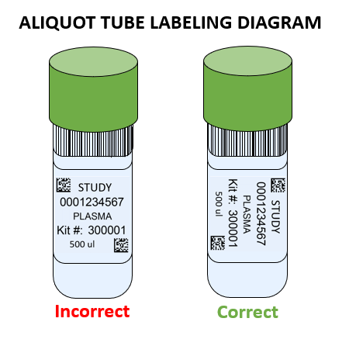
Specimen Labels: Aliquot Tubes (Plasma and Buffy Coat)
Place the label horizontally.
Place the left-hand barcode near the cap.
Notes:
On your aliquot tubes, the label should be placed horizontally, so that the left-hand barcode is near the cap.

Slide 25
Specimen Labels: Labeling Biologic Samples
Label all collection and aliquot tubes before collecting, processing or freezing samples.
Label only 1 subject’s tubes at a time to avoid mix-ups.
Wrap the label around the tube horizontally. Label position is important for all tube types.
Make sure the label is completely adhered by rolling between your fingers.
Notes:
Overall, when labeling your biological samples – please Label all collection and aliquot tubes before collecting, processing or freezing samples. Label only 1 subject’s tubes at a time to avoid mix-ups. Wrap the label around the tubes horizontally. Finally, make sure the label is completely adhered by rolling between your fingers.

Slide 26
Handling/ Processing Study Specimens
Notes:
Now we are going to move on to Handling and Processing Study Specimens.

Slide 27
Site Required Equipment
Blood Collection/Safety Equipment:
Personal Protective Equipment (PPE)
  Lab Coat, Safety Glasses
Tourniquet
Alcohol Prep Pad
Gauze Pad
Butterfly Needles
Bandage
Sharps Bin and Lid
Processing/Storage Equipment:
Centrifuge capable of ≥2000 xg with refrigeration to 4⁰C
-80⁰C Freezer
Wet Ice Bucket
Notes:
Here is a list of Site-Required Equipment. Blood collection/safety equipment that is needed includes:…

Slide 28

Blood Collection & Processing: Sample Collection Tube
Draw Order | Tube Type | Number of Tubes Drawn (per visit) | Tube Image
1 | EDTA (Lavender-Top) Tube (10 ml) | 5
Notes:
For blood collection from the subject, you will use 5 EDTA tubes per visit. Here are images of what these tubes look like.

Slide 29
Blood Collection & Processing: Aliquot Cryovials & Cap Colors
Cap Color | Sample Type
Lavender Cap | 1.5ml Plasma aliquots
Clear Cap | Buffy Coat
Blue Cap | Residual (plasma)
Notes:
Here are the aliquot tubes you will use. The aliquot tubes have different cap colors, each which correspond to a specific sample type. lavender is for 1.5ml plasma aliquots, clear is for buffy coat, blue is for residual plasma

Slide 30
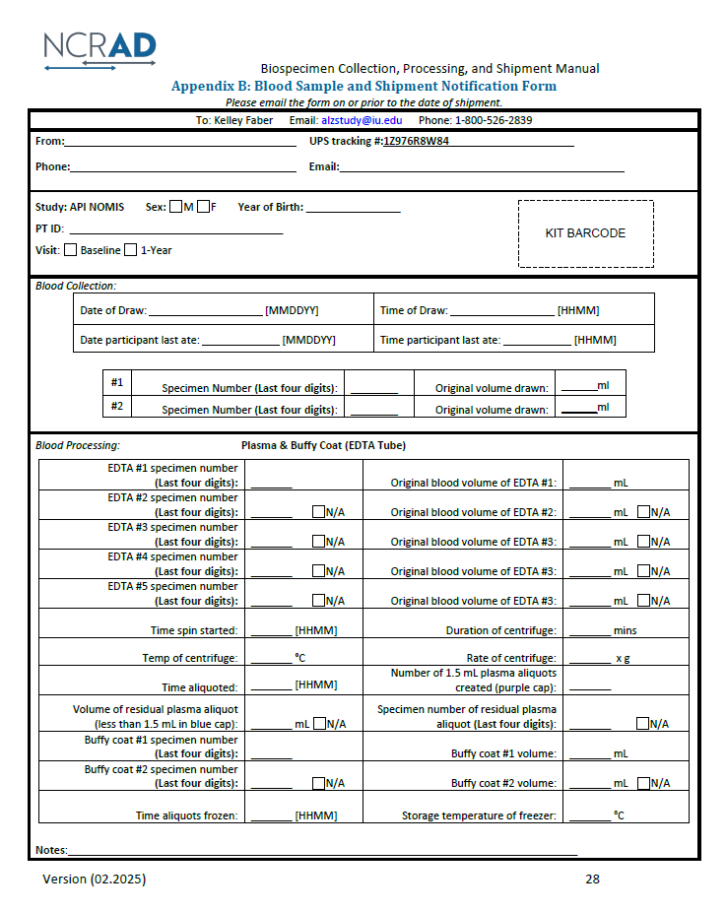
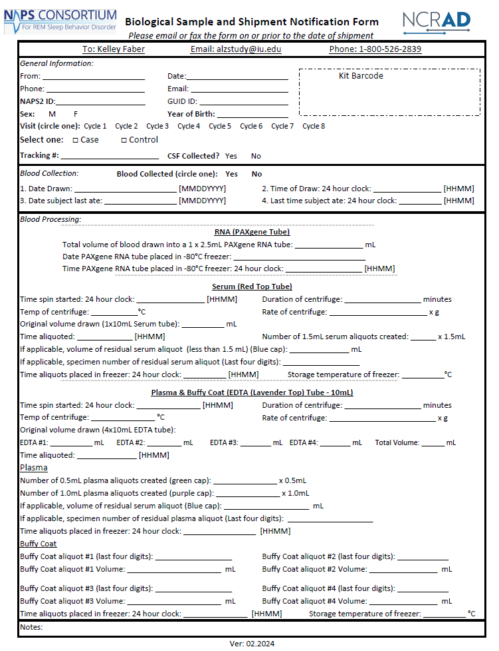
Notes:
Here is a blank copy of the new Blood Sample and Shipment Notification Form. Prior to the blood draw, pre-fill in the information you can. *CLICK*

Slide 31
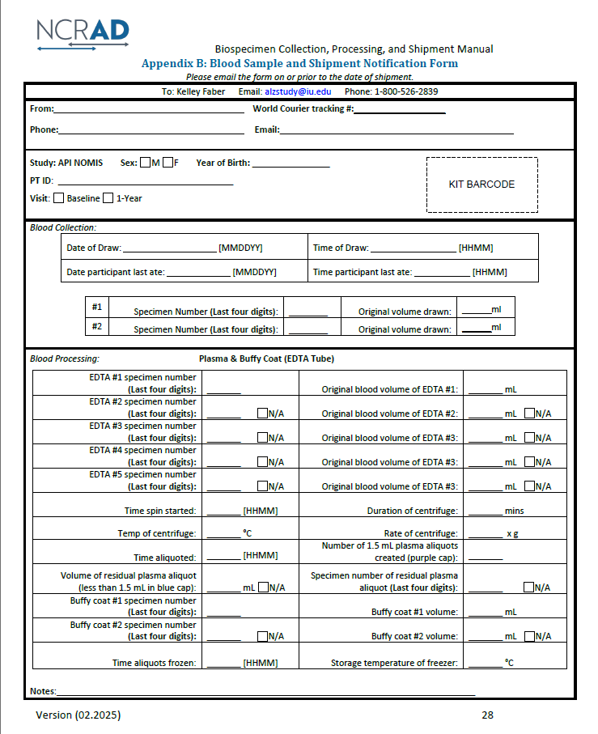
Coordinator Name
+57-111-1111111
Email@email.com
x
1900
APINOMIS-00000
x
05/08/2024

Slide 32






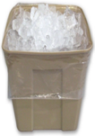


Plasma & Buffy Coat Preparation (EDTA Tubes x 5)
Step One
Step Two
Step Three
Step Four
Step Five
Step Six
Step Seven
X 16
Label purple-capped cryovials with “PLASMA” labels.
Aliquot 1.5 ml plasma into each cryovial.
2 1.5 ml vials will be provided by and stored locally at the site.
If residual aliquot is created, document specimen number and volume on Sample Form.
Store plasma aliquots upright at -80°C until shipment to NCRAD.
Step Eight
Store tubes at room temp.
Check expiration data on collection tubes.
Each tube should be labeled with Collection Tube and Site and PTID Labels.
Collect blood into each EDTA Tube, allowing blood to flow for 10 seconds and ensuring blood flow has stopped.
Immediately after blood draw, invert tubes 8-10 times to mix samples.
Place thoroughly mixed tube on wet ice until centrifugation begins.
Centrifuge samples at 2000 x g for 10 minutes at 4°C.
Pool all plasma from the 5 EDTA tubes into a 50 ml conical tube and invert gently 3 times to mix the plasma.
Label clear-capped cryovials with “BUFFY COAT” labels.
Using a clean transfer pipette, collect the buffy coat (may have residual plasma and some RBCs included).
Transfer the buffy coat from each EDTA tube into its own cryovial.
Store buffy coat aliquots upright at -80°C until shipment to NCRAD.
Spin, aliquot, and freeze all plasma and buffy coat aliquots within 1 hour of collection.
Notes:
Next we are going to go over plasma and buffy coat preparation. We talk about these specimen types together because they are both initially collected using the 5 EDTA tubes. Step one is the prep. you will store the tubes at room temperature and prior to the blood draw you will take care of labeling all of the EDTA tubes. You will collect the blood sample using the 5 10ml EDTA lavender top tubes, allowing the blood to flow for 10 seconds and ensuring that blood flow has stopped. Step 3 – after collection, immediately invert the tube 8-10 times to mix the sample. Then, centrifuge the samples at 2000xg for 10 minutes at 4C. After centrifuging, the plasma will be at the top of the tubes. Pool all of the plasma from the 4 EDTA tubes into a 50ml conical tube and invert gently 3 times to mix. Aliquot 1.5ml of plasma into the 16 lavendar top cryovials. If there is still plasma left, you should create a residual aliquot using the blue cap cryovial. If a residual aliquot is created, document the specimen number and volume on the sample notification form. Store the plasma aliquots at -80C until shipment. Now we are going to talk about the buffy coat. Using a clean transfer pipette, collect the buffy coats and transfer to the clear top cryovial tubes. Store the buffy coat aliquots at -80C until shipment. EDTA tubes must be spun, aliquoted, and stored in the freezer within 2 hours of collection.

Slide 33
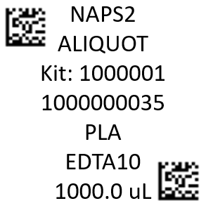
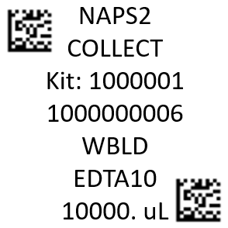
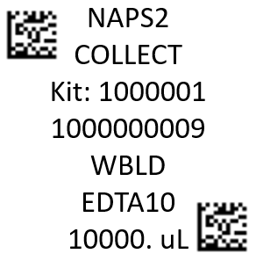
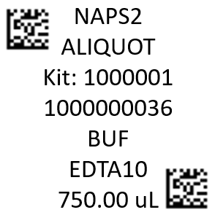

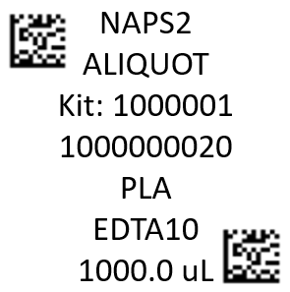
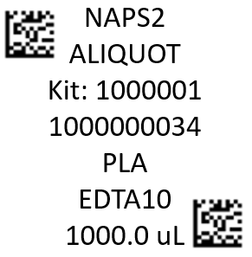
EDTA Tube – Plasma & Buffy Coat Labeling
5 x 10mL EDTA Purple-Top Blood Collection Tubes. Use the labels with:
  Sample Type = WBLD
  Volume = 10000 uL
1 x Blue-Cap Cryovial. Use the label with the highest specimen barcode number and:
  Sample Type = PLA
  Volume = 1000 uL
through
2 x Clear-Cap Cryovials. Use the 2 labels with:
  Sample Type = BUF
  Volume = 750 uL
through
16 x Purple-Cap Cryovials. Use the 16 labels with the smallest specimen barcode numbers and:
  Sample Type = PLA
  Volume = 1000 uL
through
5 x 10mL EDTA Purple-Top Blood Collection Tubes
Notes:
Here is a guide showing how to label all tubes for plasma and buffy coat collection and processing. A pre-filled in API ID label and a label with quantity equal to 10,000uL should be placed on each of the four the lavender cap EDTA collection tubes. The 16 labels with the quantity equal to 1,500uL should be placed on the purple cap cryovials. Finally, if needed, place the label with the highest specimen number and quantity equal to 1,000uL on the blue cap cryovial. This is for the residual, if collected. There are also 2 labels for the collected buffy coats.

Slide 34
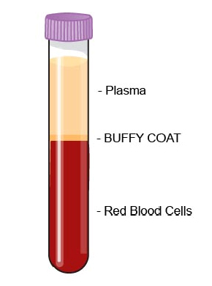

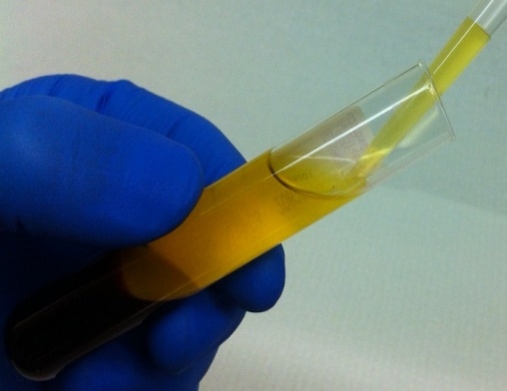
EDTA Tube – Plasma Collection
plasma
Up to 17 cryovials possible:
16 x 1.5 ml in lavender cap cryovials
1 x <1.5ml blue cap
Notes:
Here, first we see what the EDTA tube looks like after it has been centrifuged. The plasma us at the top, and the Buffy Coat is right below. Then, there is an image of someone collecting plasma out of an EDTA tube, followed by the pooled plasma. Finally, we see all the possible plasma aliquots. Remember the green cap cryovials contain 0.5 mil of plasma, the purple contain 1ml of plasma, and the blue contains a residual plasma aliquot, if available.

Slide 35
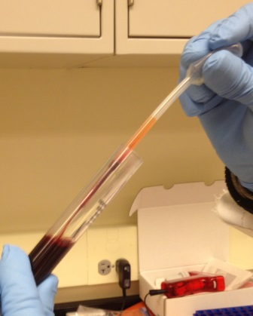

EDTA Tube – Buffy Coat Collection
Buffy Coat Aliquot
(Please use CLEAR CAP cryovial)
Notes:
Here we start with the same two images from the previous slide. We see what the EDTA tube looks like after its been centrifuged, with the buffy coat in the center. After the plasma has been taken out of an EDTA tube, the buffy coat will be the next exposed layer. In the middle image, we see of someone collecting buffy coat out of the EDTA tubes to aliquot it. The buffy coat from each of the EDTA tubes should be aliquoted into its own clear cap cryovial.
Sites also have the option of storing 1-2 buffy coats per participant per visit locally.

Slide 36
Sample Shipping
Notes:
Now we are going to move on to sample shipping.

Slide 37
Sample Shipment Summary
Sample Type | Tube Type | Study Visits Collecting Biospecimens | Typical # of tubes sent to NCRAD | Ship
Whole blood for isolation of plasma & buffy coat | PLASMA: 2 ml cryovials with lavender caps (residual volume placed in 2 ml cryovial with blue cap) | All Cycles | 16-17 | Frozen
 | BUFFY COAT: 2 ml cryovial with a clear cap | All Cycles | 2 | Frozen
Notes:
Here is a sample shipment summary. You may send up to 17 plasma, and 2 buffy coat aliquots for a single blood visit. All samples are shipped frozen.

Slide 38
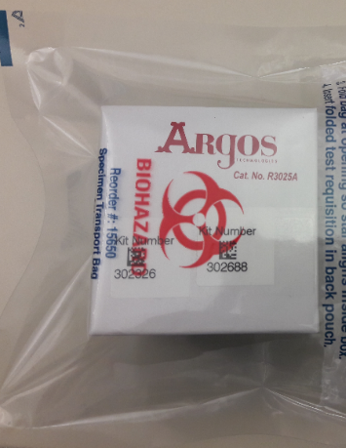
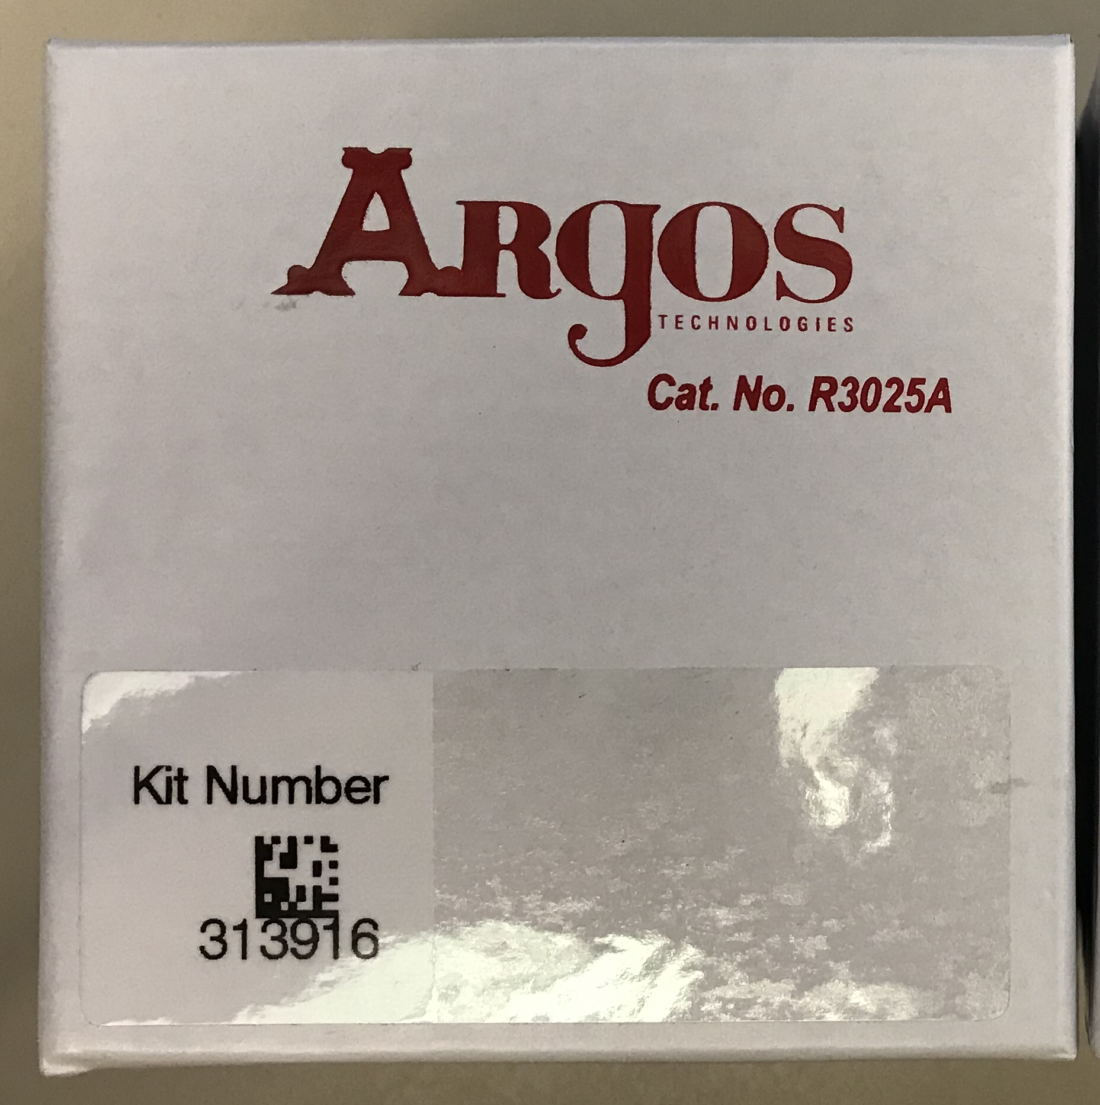
Frozen Shipping: Cryoboxes
Place plasma/buffy coat aliquots in a cryobox and place in biohazard bag. Seal biohazard bag according to the instructions on the bag. Be sure to adhere a Kit Number Label on the lid of each cryobox.
Place only ONE cryobox per Biohazard bag.

Slide 39
Shipping with World Courier
When you are ready to ship samples back to NCRAD, contact the NCRAD coordinator (iharms@iu.edu). NCRAD will work with your site and World Courier to arrange a shipment. Prior to pick up, please keep samples stored in a -80°C freezer.
There will be a waiting period between when you contact NCRAD to instigate a shipment and when the shipment occurs, which is expected to be up to 7 business days. For this reason, you should contact NCRAD about shipment approximately two weeks before you intend to ship.
World Courier will arrive with all of the supplies necessary for packaging and shipping the samples. Please note that World Courier will not handle unpackaged samples. Therefore, a site coordinator will need to place the samples into the packaging provided by World Courier. It is imperative that a site coordinator is available to assist World Courier when they arrive.

Slide 40
Shipping Frozen Samples
Contact NCRAD Coordinator for World Courier Scheduling
Send Sample and Shipment Notification Forms to IU ahead of shipment
  Email: alzstudy@iu.edu

Slide 41
Shipping Regulations and Training
PLEASE NOTE:
All study personnel responsible for shipping should be certified in biospecimen shipping.
It is the responsibility of each site to ensure that the appropriate training has been provided and conducted in regards to IATA shipping.
Please see following slides for resources.

Slide 42
Federal Regulations/Training
Sites are responsible for ensuring proper training is obtained.
Current federal and international regulations require anyone directly involved with the shipment of potentially infectious materials and other regulated biological materials (including biological specimens and cultures) be properly trained on pertinent shipping requirements.
  International Air Transport Association (IATA) Training
DGI Training Center 800-338-2291 DGItraining.com Provides IATA Certified Air Seminars and online courses | IATA Training Schools North America 1(514)390-6726 Europe, Africa & Middle East 41 (22) 799 2751 Asia, Australia & the Pacific 65 239 7232 www.iata.org Training schools located in 30 countries
Saf-T Pak Inc. www.saftpak.com Provides dangerous goods training via CD or on-site instruction for North America and Europe

Slide 43
UN3373 Biological Substance, Category B Training
Biological Substance, Category B are specimens being transported for “investigational purposes”
Recommend: investigator sites document training of category B/dangerous goods
We recommend establishing a record of your staff’s training and date of instruction
The training records must be made available upon request by the appropriate national authority
  Additional information from the Department of Transportation (DOT) can be found on their website http://hazmat.dot.gov

Slide 44
Biological Sample and Shipment Notification Forms

Slide 45
Biological Sample and Shipment Notification Forms
A copy of the sample form must be emailed to NCRAD prior to the date of sample arrival.
Please include sample forms in all shipments of frozen samples.
Email: alzstudy@iu.edu

Slide 46
Biological Sample and Shipment Notification Form: Blood
Blood Collection for:
  Plasma
  Buffy Coat
Send by E-mail prior to shipment, and include a copy in each shipment
REMINDER: PLEASE make sure this form is filled out completely by the person collecting the samples AND the person processing.
Notes:
This is the Biological Sample and Shipment Notification form for Blood. This cover blood collection for Whole Blood, Serum, Plasma, and Buffy Coat. This should be filled out completely by the person collecting the samples and the person processing the samples. You should email a copy of this completed form to NCRAD prior to shipment. You should also include a hard copy in the shipment itself.

Slide 47
https://www.ncrad.org/about
NCRAD Website
Notes:
Now we will briefly go over the NCRAD website.

Slide 48

Notes:
This is what the landing page now looks like.

Slide 49
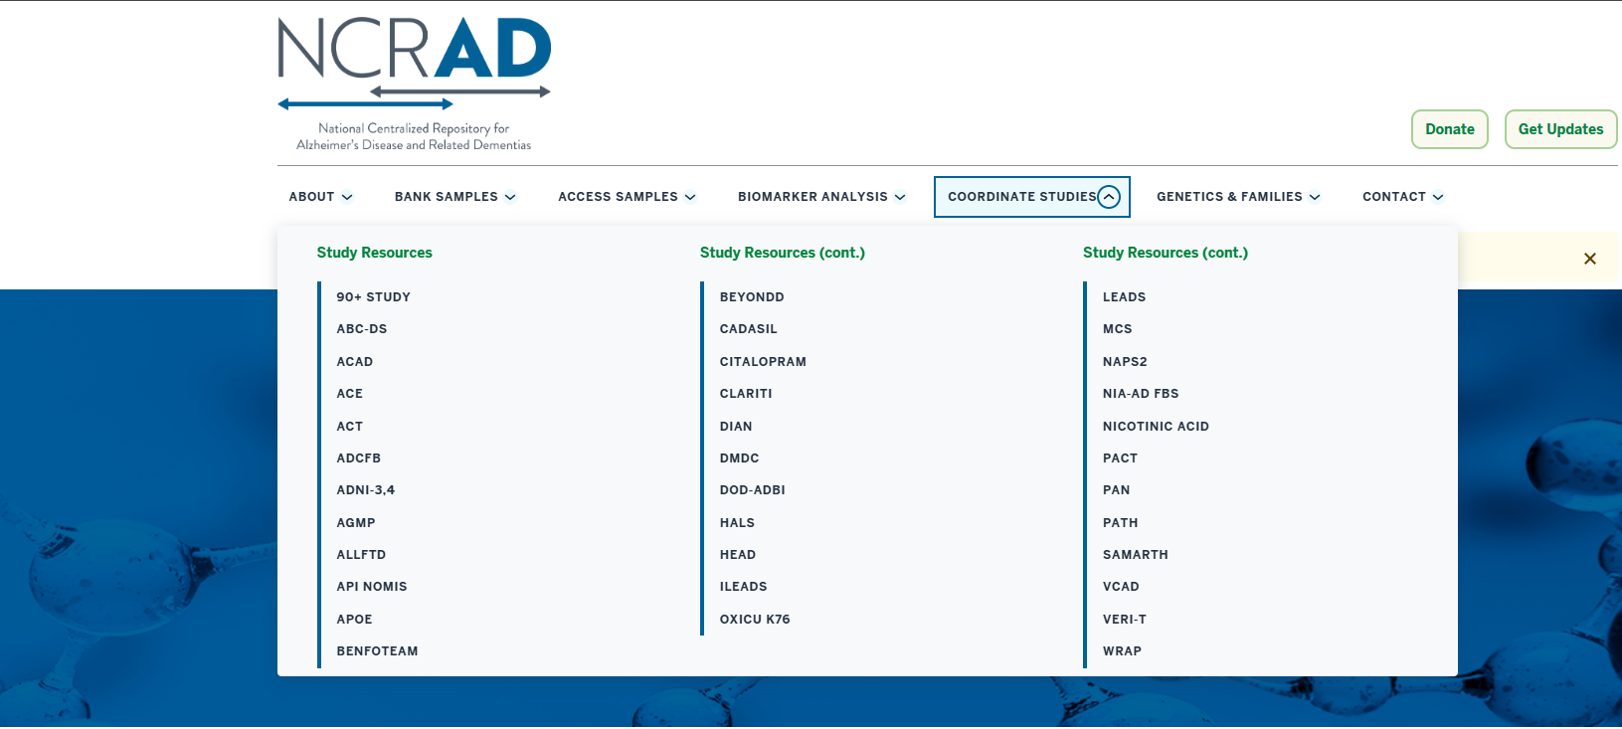
Notes:
To navigate to the NAPS2 study page, click the arrow next to “Coordinate Studies.” Then select NAPS2

Slide 50
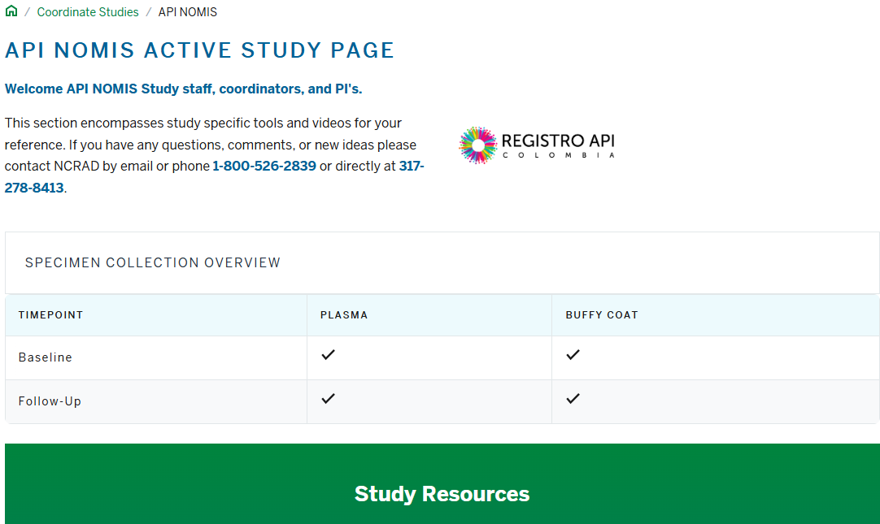
NCRAD Website: API NOMIS Active Study Page
https://ncrad.org/coordinate-studies/api-nomis
Training slides, manual of procedures, and sample forms are available for reference on the API NOMIS Active Study Page.

Slide 51
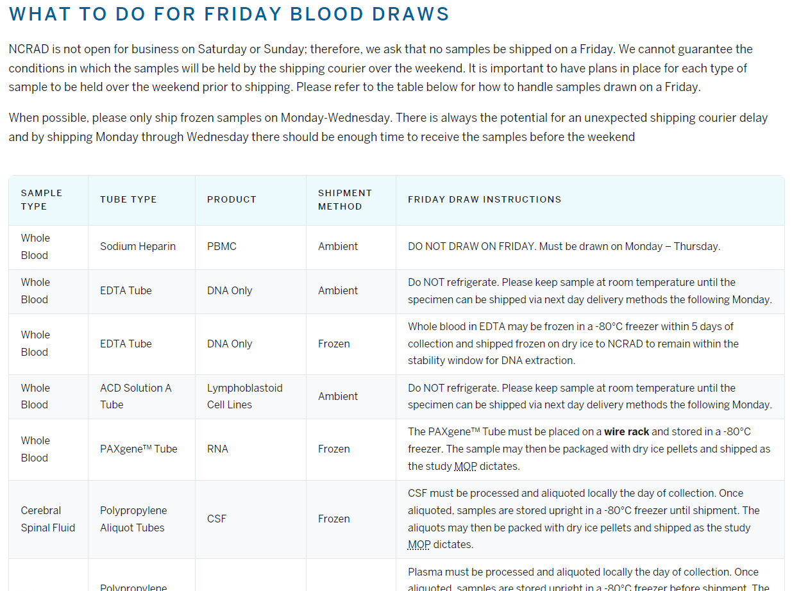
NCRAD Website: Friday Blood Draws
https://ncrad.org/contact/friday-blood-draws
Notes:
Here is a helpful page on our website that covers what do in the case of a Friday Blood Draw.

Slide 52
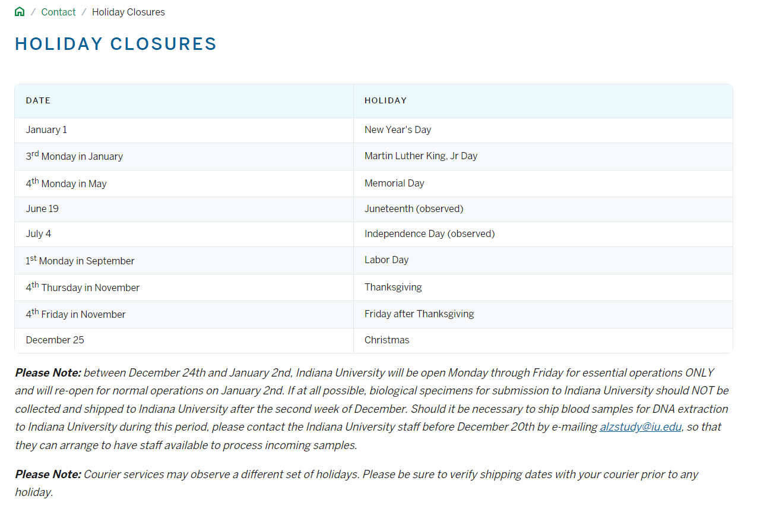
NCRAD Website: Holiday Closures
https://ncrad.org/contact/holiday-closures
Notes:
This is another helpful page outlines NCRAD Holiday Closures.

Slide 53
Contact Information
Questions?
Please contact NCRAD Coordinators at:
  Phone: 1-800-526-2839 or 1-317-278-1980
  E-mail: alzstudy@iu.edu or iharms@iu.edu
  Website: www.ncrad.org

