Slide 1
A Seamless Phase 2A-Phase 2B Multi-Center Trial to test the Benefits of Benfotiamine on the Progression of Alzheimer’s disease (BENFOTEAM)
Biospecimen Collection and Shipment training

Slide 2
Content
Biospecimen Collection Schedule
Kit Request Module
Specimen Labeling Instruction
Specimen Collection and Processing
Shipment Packaging and Forms
Creating Airbills and Scheduling Pick Ups
Other Requirements: MTAs, IATA Training
Non-Conformance Issues
NCRAD Resources and Contact

Slide 3
Benfotiamine Biospecimen Collection Schedule
 | Pre-Dose |  |  |  | Post Dose |  |  |  | Optional
 | Whole Blood | Plasma | Buffy Coat | Washed Erythrocyte | Whole Blood | Plasma | Buffy Coat | Washed Erythrocyte | CSF
Screening |  | X | X
Baseline | X | X | X | X | X | X | X | X | X
Week 8 | X | X | X | X | X | X | X | X
Week 72 | X | X | X | X |  |  |  |  | X

Slide 4
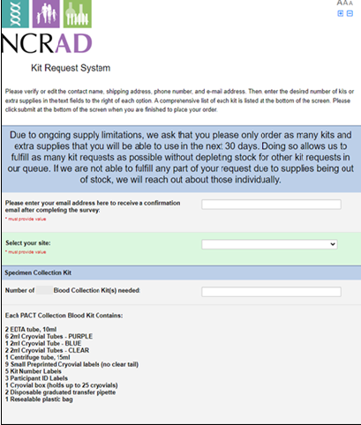
Kit Request Module
Ordering Blood Kit Supplies
Ex: tubes, pipettes, labels, cryobox
Ordering Frozen Shipment Supplies
Ex: styrofoam container, cardboard shipper, shipping stickers
Allow for three weeks from time of order to receipt of supplies
Initial order should be received prior to site start date

Slide 5
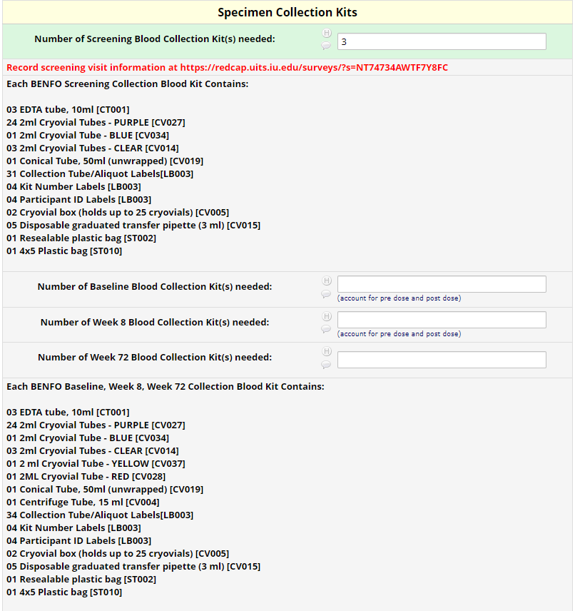
Kit Request Module Instruction
www.kits.iu.edu/BENFO
Verify site shipping address and contact information
Enter kit order amount
Screening Kit->Screening Shipping Kit
Baseline, Week 8, Week 72->Batch Shipping Kit
All screening visits must be entered into screening tracker prior to shipping. Reminder in kit request module
Supplemental kit will be sent with initial order. This kit contains the saline needed for washed RBCs. Only one supplemental kit should be order per year.
*Allow for 3 weeks for kits to arrive when placing order
Notes:
Please do not order in bulk. Kits do expire. Plan for a month in advanced

Slide 6
BENFO Screening Reporter www.kits.iu.edu/BENFOScreening
Enter date of each screening visits and Participant ID
Tracker allows for 3 screening visits per form. If there are more than 3 screening visits scheduled, submit another survey.
Allows for efficient processing to return inclusion/exclusion results

Slide 7
GUID (Globally Unique Identifier)
The GUID is a participant ID that allows researchers to share data specific to a study participant, without exposing personally identifiable information.
Participation is optional. If a patient chooses to participate:
1. Create an account: https://bricsguid.nia.nih.gov/portal/jsp/login.jsp
2. Once you have an account, go to the GUID Tool – Create GUID
3. To open the ‘Launch GUID Tool’ you will need to have Java installed on your device
4. In order to generate a GUID, the following PHI is required on the Appendix A.

Slide 8
Specimen Labeling Instruction

Slide 9
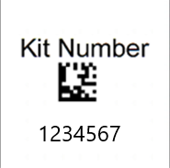
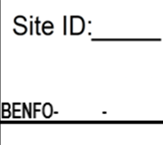
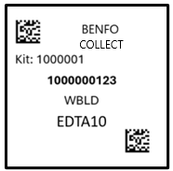
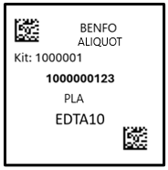
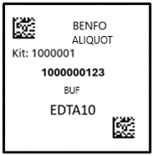
Specimen Labels
Kit Number Label
Ties all biospecimens and kit contents together for each participant
Placed on Cryobox and Blood Sample and Shipment Notification Form
Participant ID Label
Handwritten by sites according to unique study ID
Placed on blood collection EDTA tubes
Collection Tube Label and Aliquot Label
Specific to type of biospecimen
Contains unique Specimen# and Kit#
Place on corresponding EDTA collection tube and processed aliquot cryovials

Slide 10
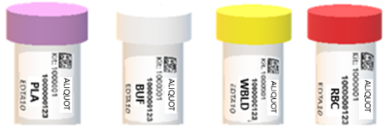
Collection tube and Aliquot Labels
Specimen Type Abbreviations
WBLD ‐ Whole Blood
PLA ‐ Plasma
BC ‐ Buffy Coat
RBC- Washed RBC
CSF ‐ Cerebrospinal Fluid

Slide 11
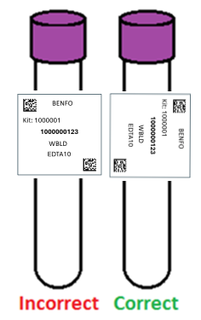
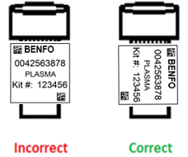
Specimen Labeling Instruction: Label Placement Details
Write site ID and participant ID with fine-point marker prior to label placement
Place all labels on Whole-Blood EDTA 10 ml tube and Cryovial 2 ml before blood collection, processing, or freezing
Label collection tubes and cryovials for one participant at a time to avoid mix ups.
Wrap labels horizontally and adhere completely to all tubes
Collection Tube Label Diagram
Aliquot
Label Diagram

Slide 12
Specimen Collection and Processing

Slide 13
Benfotiamine Biospecimen Samples
NCRAD will provide training and materials for the following biospecimens collected:
Whole Blood
Plasma
Buffy Coat
Washed RBCs
CSF (Optional)

Slide 14
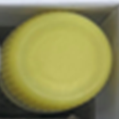
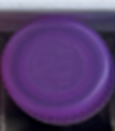
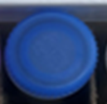
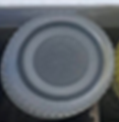
Sample Type | Cryovial Cap Color | Example:
Whole Blood | Yellow
Plasma | Purple
Residual Plasma | Blue
Buffy Coat | Clear
Washed RBC | Red
Local Lab CSF | Yellow
Processed CSF | Clear
Residual CSF | Blue

Slide 15
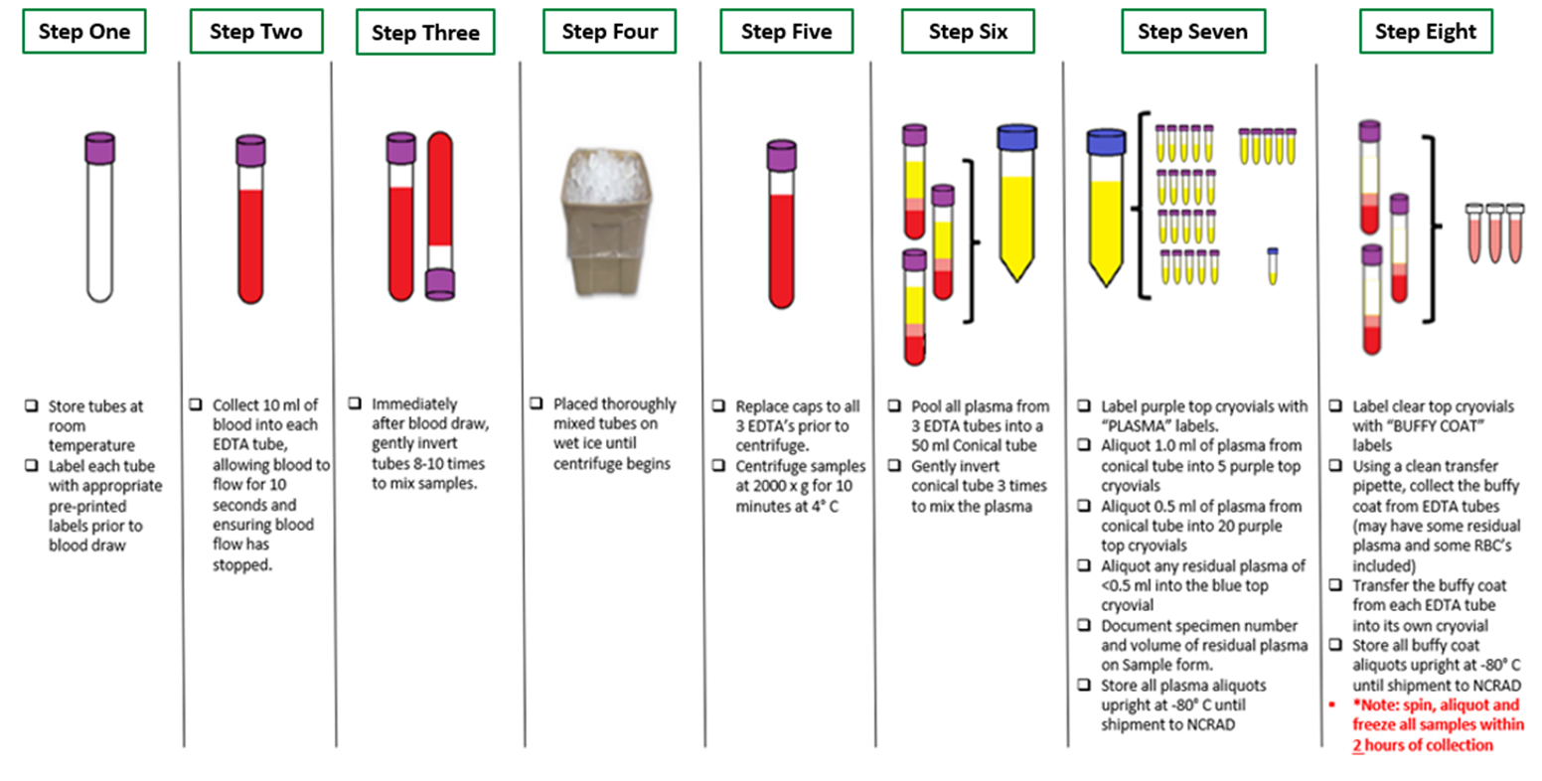
SCREENING VISIT- PROCESSING PLASMA AND BUFFY COAT ONLY

Slide 16
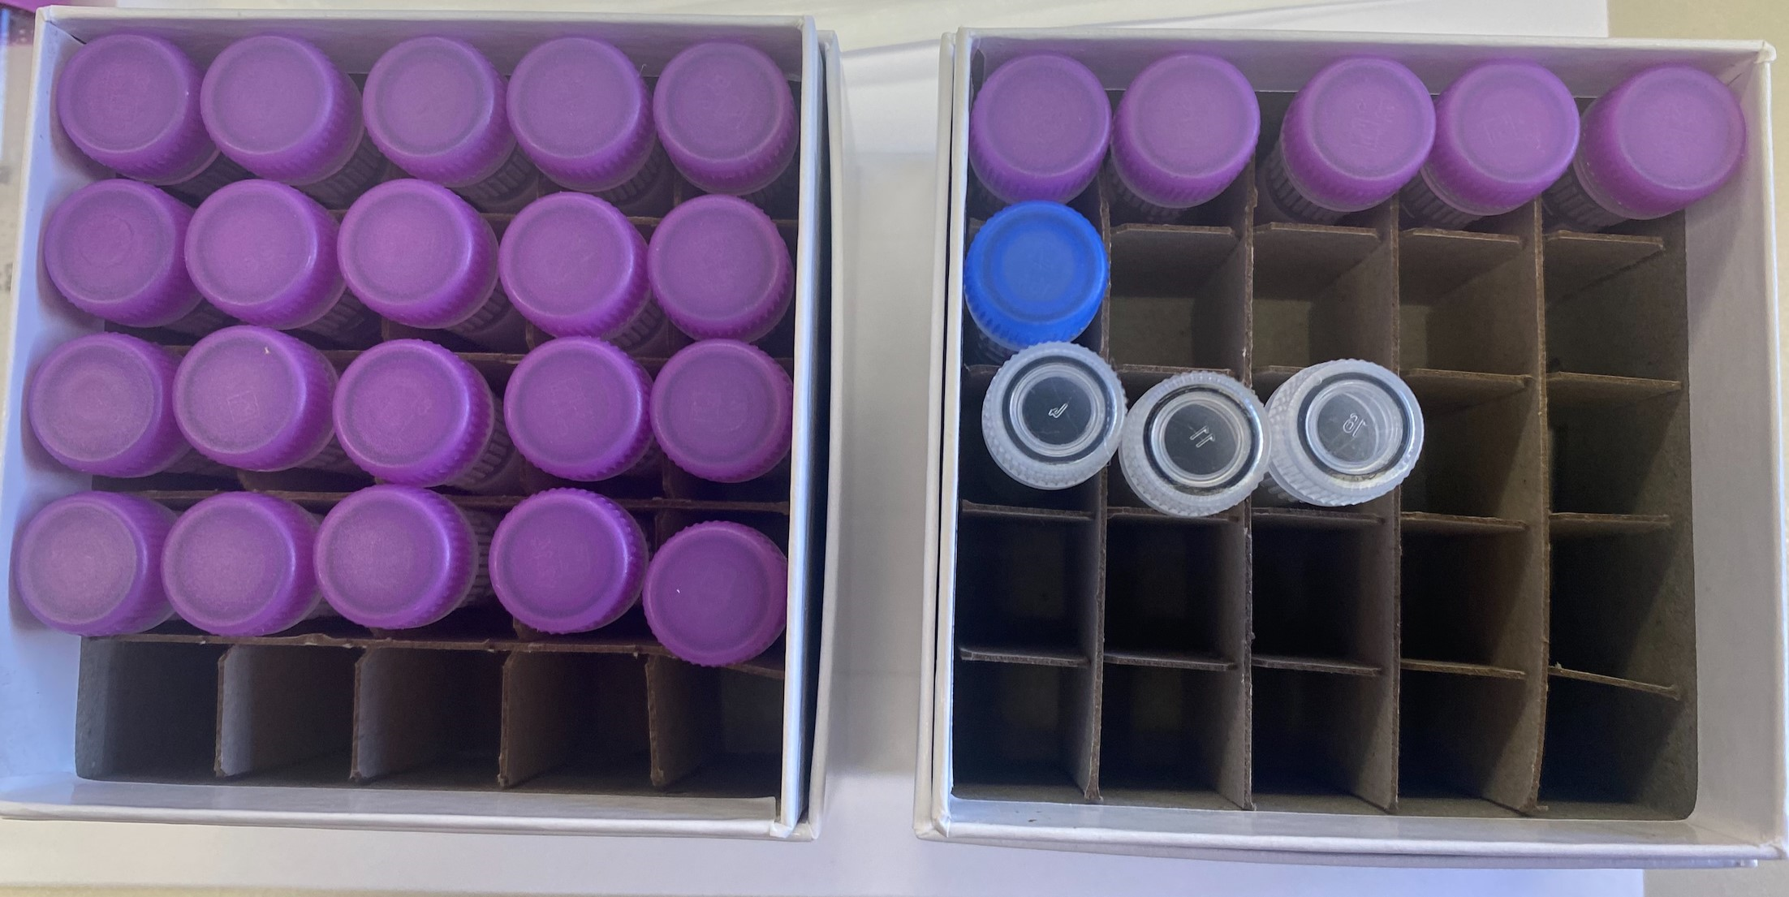
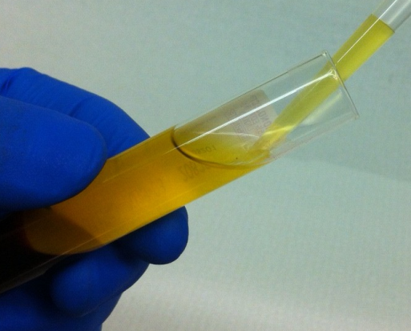
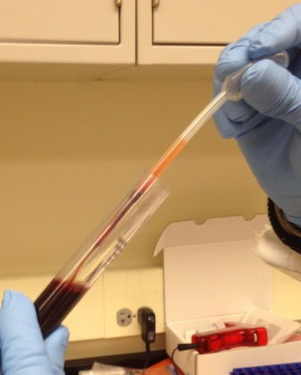
Specimen Collection and Processing: Plasma and Buffy Coat Collection (Screening)
Plasma
Buffy Coat
Red Blood Cells
50 ml Conical with 30 ml pooled plasma after inversion
Retrieve buffy coat from each EDTA (expected to have reddish color from RBCs)
Cryobox #1
20 purple-capped - 0.5 ml of plasma
Cryobox #2
5 purple-capped – 1.0 ml of plasma
1 blue-capped – <0.5 ml residual plasma
3 clear-capped – ~1.0 ml buffy coat

Slide 17
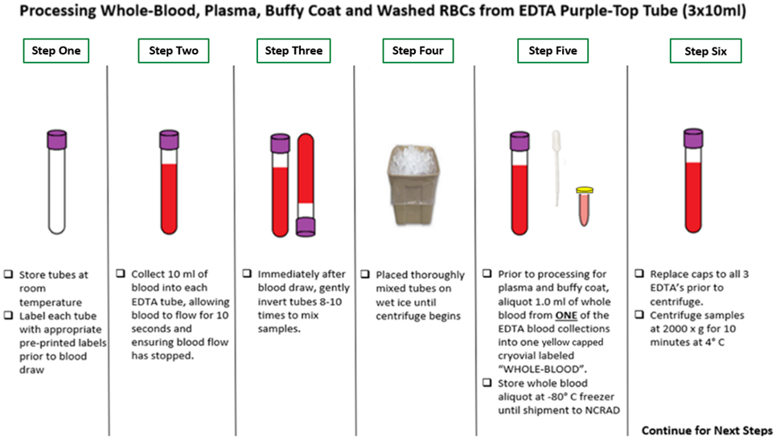
BASELINE, WEEK 8, WEEK 72
Processing Whole-Blood, Plasma, Buffy Coat, and Washed RBCs

Slide 18
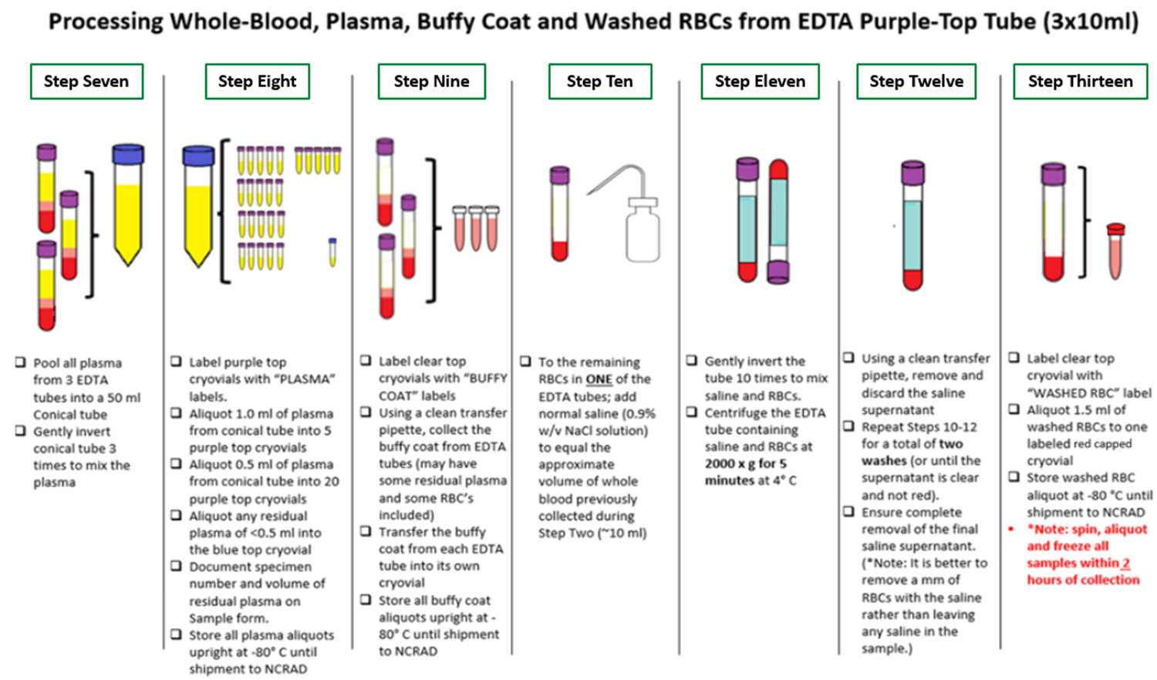
BASELINE, WEEK 8, WEEK 72
Processing Whole-Blood, Plasma, Buffy Coat, and Washed RBCs

Slide 19
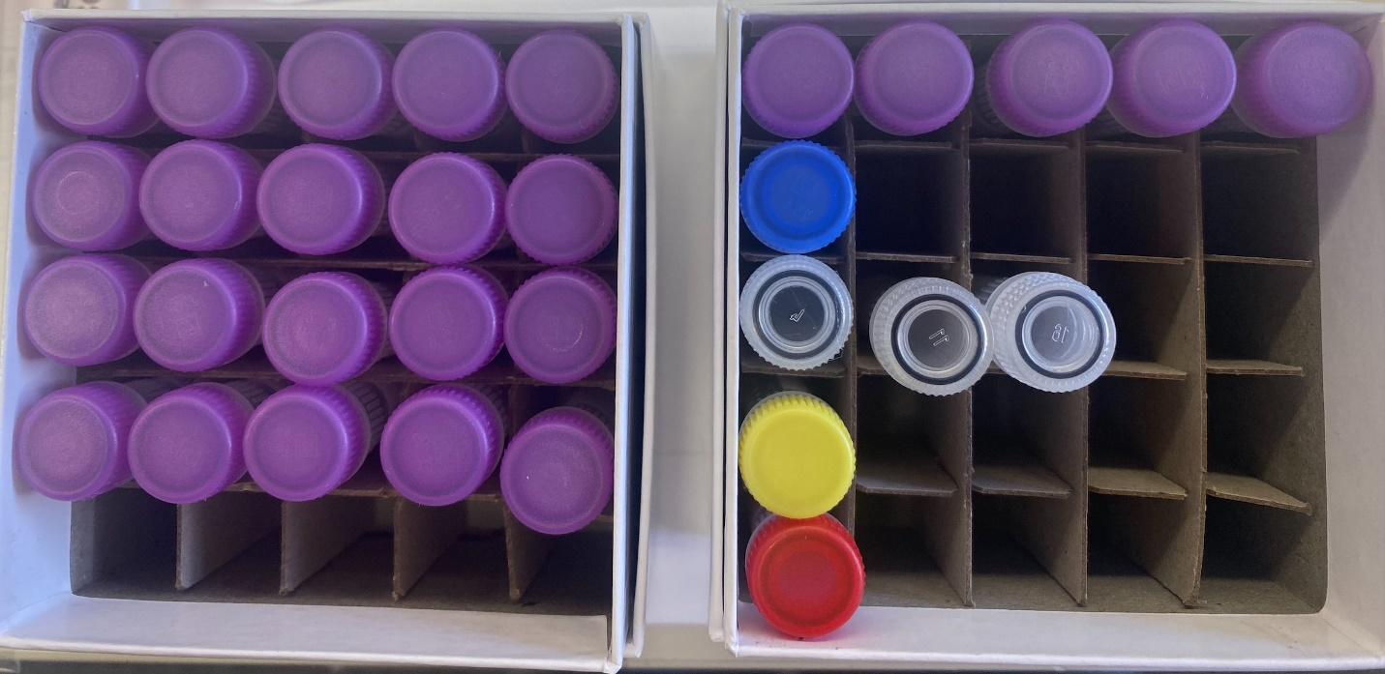
Visit | Pre-Dose | Post-Dose
Baseline | X | X
Week 8 | X | X
Week 72 | X
Cryobox #1
20 purple-capped - 0.5 ml of plasma
Cryobox #2
5 purple-capped – 1.0 ml of plasma
1 blue-capped – >1.0 ml residual plasma
3 clear-capped – ~1.0 ml of buffy coat
1 yellow-capped – 1.0 ml of whole blood
1 red-capped – 1.5 ml of washed RBCs

Slide 20
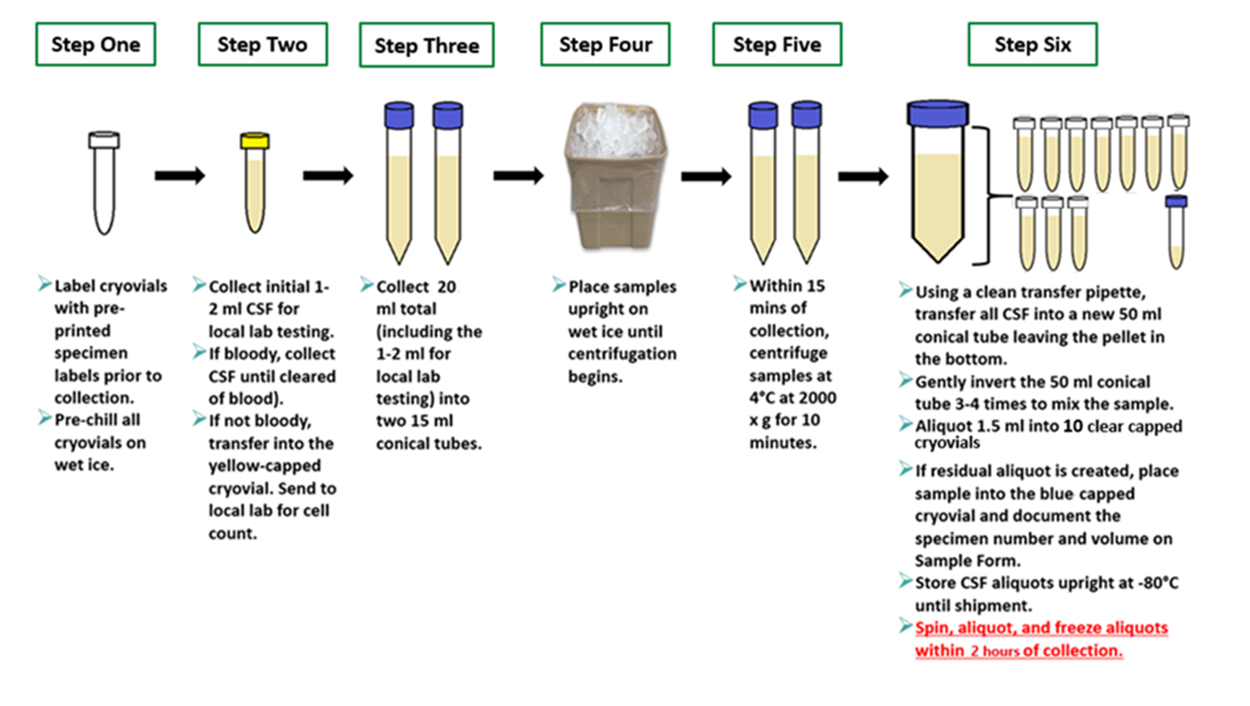
Optional Baseline and Week 72
CSF Preparation

Slide 21
Shipment Packaging, Labeling, & Forms

Slide 23
Frozen Shipment Tutorial
https://ncrad.org/shipping_address.html

Slide 24
Specimen Packaging and Shipment: Frozen Specimen Packaging
Step 1. Place frozen cryobox in biohazard bag with absorbent sheet
Important: Confirm kit number label has been placed on the outside of cryobox

Slide 25
Specimen Packaging and Shipment: Frozen Specimen Packaging
Step 2. Place 2-3 inches of dry ice in the bottom of the styrofoam shipping container
Step 3. Insert cryoboxes with tubes upright
Step 4. Fully cover all cryoboxes with 2 inches of dry ice
Reminder:
Screening Shipper holds 2 cryoboxes
Batch Shipper holds 8 cryoboxes
Notes:
If samples freeze at an angle or upside down it ruins the quality of the sample.

Slide 26
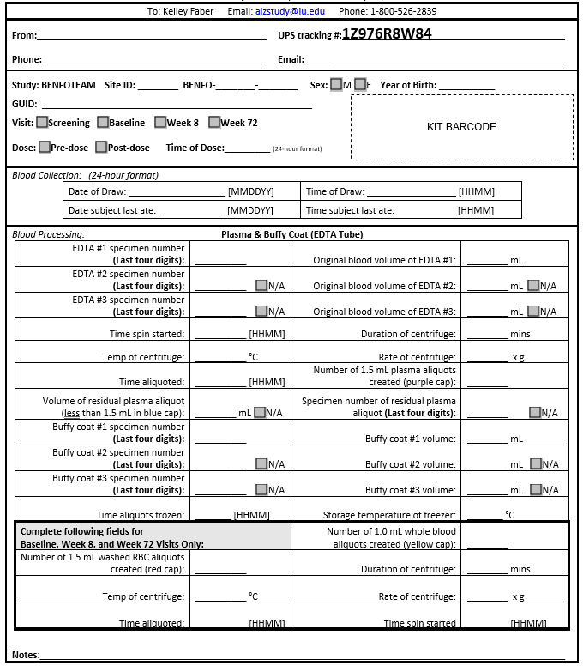
Blood Sample and Shipment Notification Form
Step 5.Include Blood Sample & Shipment Notification Form in Cardboard Shipper
Fill out completely during study visit
Include Kit Number Label on Form
Take a copy of each form prior to shipment. E-mail or fax NCRAD for notification
Email: alzstudy@iu.edu
Fax: 317-321-2003
Notes:
You will need one physical form included in shipment and also send an electronic copy to us before your package goes out. If there are 8 cryboxes, we should receive 8 of these forms.

Slide 27
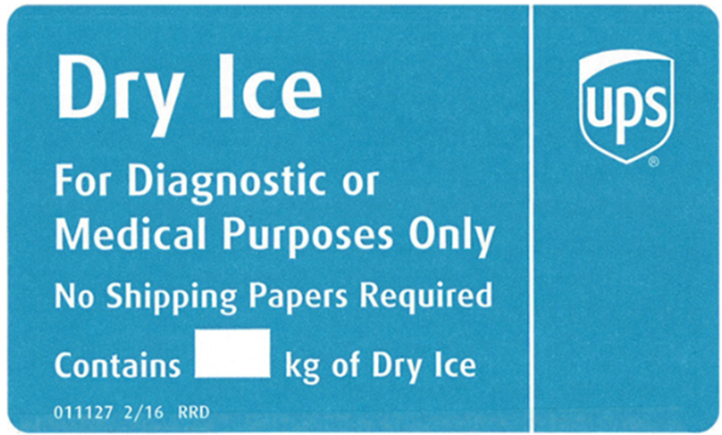
Specimen Packaging and Shipment: Cardboard Package Labeling
Step 6.
20
Dangerous Goods Label
Additional Training Required
Net weight of dry ice in kg
Notes:
20 kg is 40 lbs

Slide 28
Creating Airbills & Scheduling Pickups

Slide 29
Shipping Accounts
https://redcap.link/BENFOaccountsurvey
One person from each site must fill out this survey in order to set up accounts with NCRAD.

Slide 30
Navigating UPS ShipExec Tutorial
https://ncrad.org/shipping_address.html

Slide 31
UPS ShipExecTM Thin Client Website
Log into the ShipExec Thin Client: https://kits.iu.edu/UPS
Click on the “Shipping” dropdown and click on “Shipping and Rating”

Slide 32
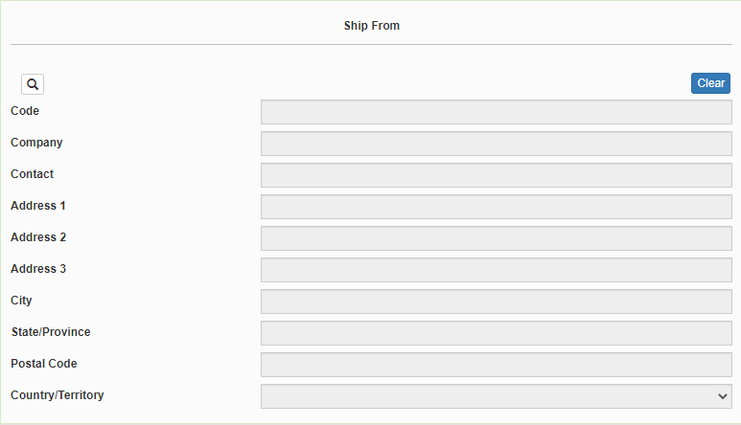
Creating Airbills & Scheduling Pick Ups: Finding your Contact Information
On the right side of the screen, choose the name of your study from the “Study Group” drop down menu
This step must be done 1st
On the left side of the screen, Click on the magnifying glass icon

Slide 33
Creating Airbills & Scheduling Pick Ups: Finding your Contact Information
On the right side of the screen, a list of all the site addresses within the study you selected should populate
User can filter the search for their address further by filling in the “Company”, “Contact”, or “Address 1” fields
Please verify that both the shipping information AND study reference are correct for this shipment
If any information needs to be updated, please reach out to the NCRAD Coordinator of your study

Slide 34
Creating Airbills & Scheduling Pick Ups: Entering Shipment Information
Enter the total weight of your package in the “Weight” field
Enter the dry ice weight in the “Dry Ice Weight” field
The “Dry Ice Weight” field cannot be higher than the “Weight” field (will receive an error message)

Slide 35
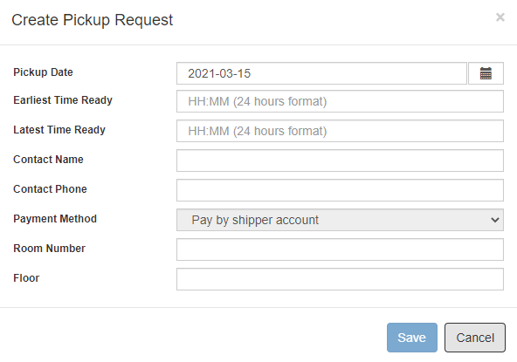
Creating Airbills & Scheduling Pick Ups: Scheduling Pickup Request
Click on the “Pickup Request” button
Fill out all fields for the pickup request
Enter in the “Earliest Time Ready” and “Latest Time Ready” in 24-hour format separated by colon.
Choose a name and number that is the best to contact if the UPS driver has questions related to picking up your package
Entering the Room Number and Floor will help the UPS driver locate your package
Hit “Save” when done

Slide 36
Creating Airbills & Scheduling Pick Ups: Shipping Packages
If all fields in “Ship From” and “Shipment Information” fields are completed, and pickup request is completed (if necessary) then click “Ship” in the bottom right corner of the page

Slide 37
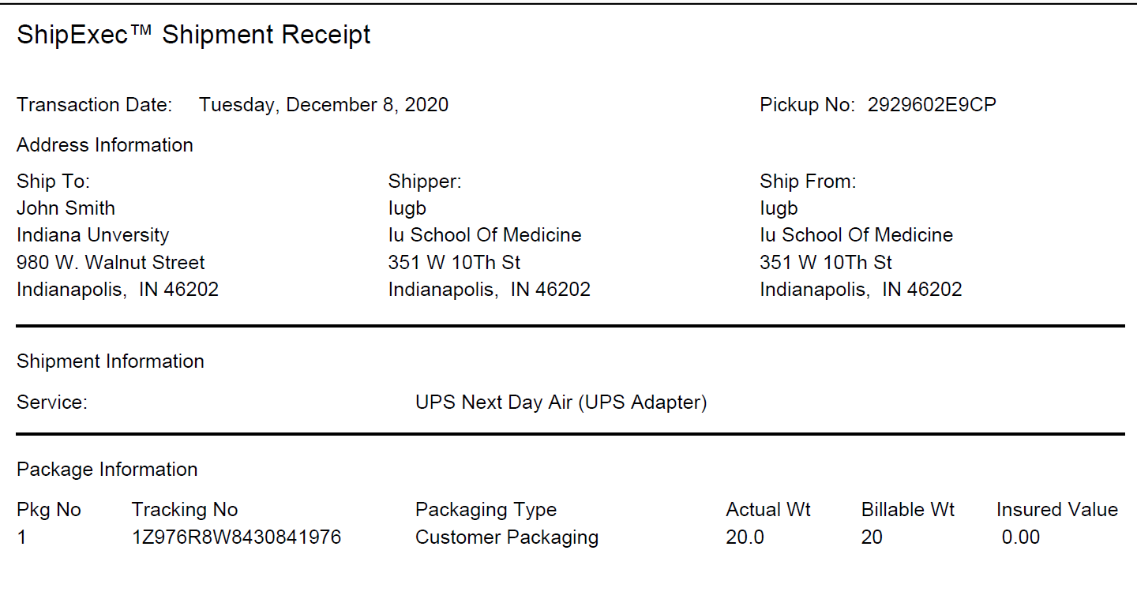
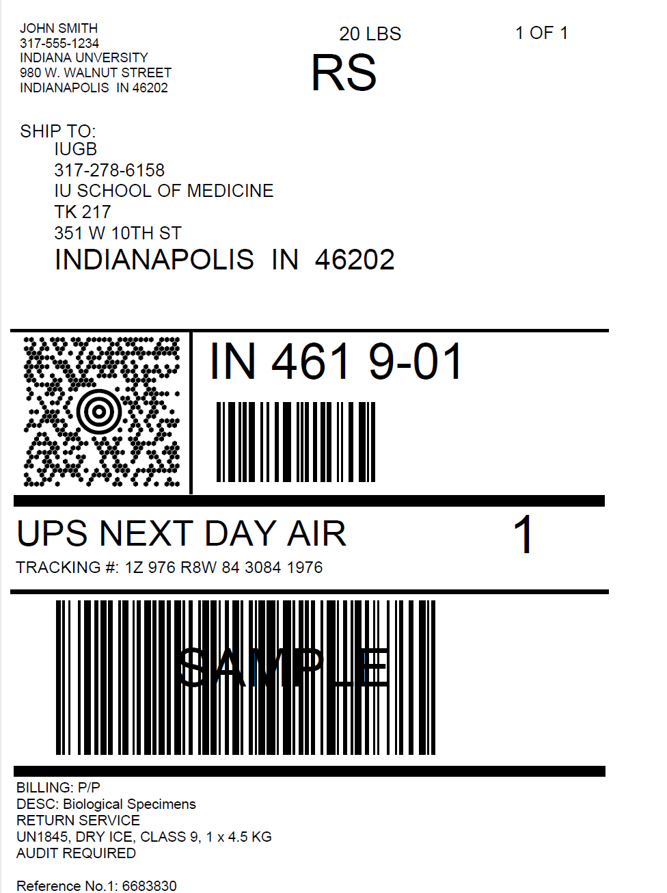
Shipment Receipt
Airbill
Check Pickup Status by going to UPS.com, click on the Shipping, select Schedule a Pickup, and look on the right side of screen to click on “Pickup Request Status”. Enter in the Pickup No. listed on receipt into PRN field and submit

Slide 38
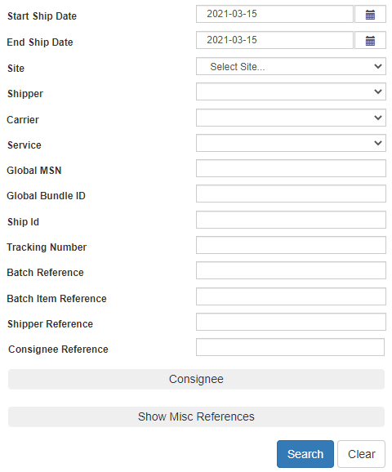
Creating Airbills & Scheduling Pick Ups: Reprinting/Voiding Airbills
Reprint
Void
To reprint airbill or void a shipment, click “History” at the top of the ShipExec Thin Client portal
If your shipment doesn’t automatically pop up, enter in the date of shipment and then click “Search”

Slide 39
Requirements Prior to Collections:
Material transfer agreement
IATA biospecimen shipment training
Master Material Transfer Agreement must be in place with Institution prior to receiving kits from NCRAD
Appendix A for BenfoTeam study must be completed by Investigator prior to receiving kits from NCRAD
All study personnel responsible for shipping should be certified in biospecimen shipping
It is the sites responsibility to provide additional training according to federal regulations including UN3373 Biological Substance Category B
Resources:
International Air Transport Association Training (IATA) www.iata.org
UN3373 http://hasmat.dot.gov

Slide 40
Non-Conformance Issues

Slide 41
Non-Conformance | Solution
Low volume aliquots | Put cryovials in a row, aliquoting in order until sample is depleted
Tubes received frozen at an angle/inverted | Carefully place tubes upright in freezer and in shipper
Aliquots are not labeled or labeled incorrectly | Refer to training or MOP for correct label placement. Save all labels until samples are packed for shipping.
All frozen samples for one participant are not sent within one shipment box | Keep plasma and buffy coat for individual participants together. Use one cryobox per participant
Fields on Blood Sample and Shipment Form left blank or incorrect data is given | Complete Blood Sample and Shipment Form during participant’s study visit while samples are processed
Blood Sample and Shipment Forms are not e-mailed or faxed to NCRAD before shipment arrives | Make copy of participants completed form after visit and save until shipment.

Slide 42
Resources
Kit Request Module: www.kits.iu.edu/BENFO
Screening Visit Reporter: www.kits.iu.edu/BENFOScreening
BENFO Webpage on NCRAD website: www.ncrad.org/coordinate-studies/benfoteam
Training and Account Survey: https://redcap.link/BENFOaccountsurvey

Slide 43
Contact Information
Questions?
Please Contact NCRAD Coordinator at:
Phone: 1-800-526-2839
Benfo Coordinator E-mail: eridelan@iu.edu
NCRAD General E-mail: alzstudy@iu.edu
Website: www.ncrad.org/coordinate-studies/benfoteam

