Slide 1
Collection and Shipment Training
Citalopram Study

Slide 2
Training Overview: Citalopram
GUIDs
Kit Review
Sample Collection and Processing
Sample Form
NCRAD Website
Common Nonconformance Issues
Sample Shipping
Questions?

Slide 3
Globally Unique Identifier (GUID)
The GUID is a subject ID that allows researchers to share data specific to a study participant, without exposing personally identifiable information
A GUID is made up of random alpha-numeric characters and does not include any PHI in the identifier

Slide 4
Globally Unique Identifier (GUID)
Create an account: https://bricsguid.nia.nih.gov/portal/jsp/login.jsp
Once you have an account, go to the GUID Tool – Create GUID
To open the ‘Launch GUID Tool’ you will need to have Java installed on your device
When the GUID Tool is open, you will need all of the following information
  Complete legal given (first)name of participant at birth
  The participant’s middle name, if applicable
  Complete legal family (last) name of subject at birth
  Day of birth
  Month of birth
  Year of birth
  Name of city/municipality in which subject was born
  Country of birth

Slide 5
Citalopram Study Specimens
Sample Type | Baseline Visit
Whole blood | X

Slide 6
Kit Request Module
http://kits.iu.edu/citalopram/

Slide 7
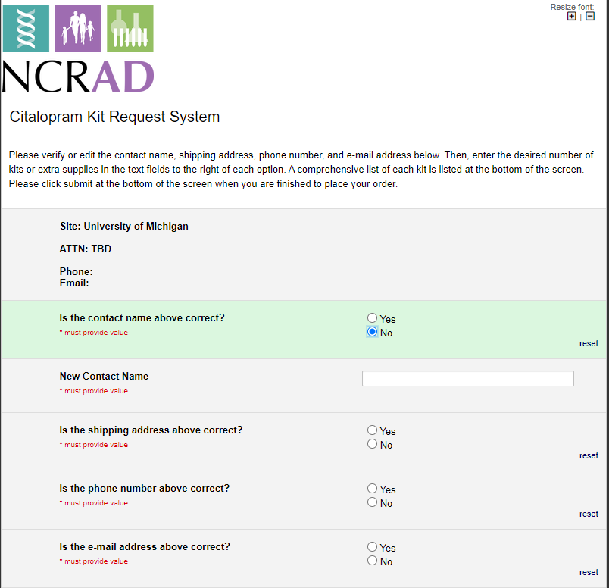
Citalopram Kit Request Module
The coordinator name and contact information will appear (once confirmed).
Verify that this information is accurate, or correct it if necessary.

Slide 8
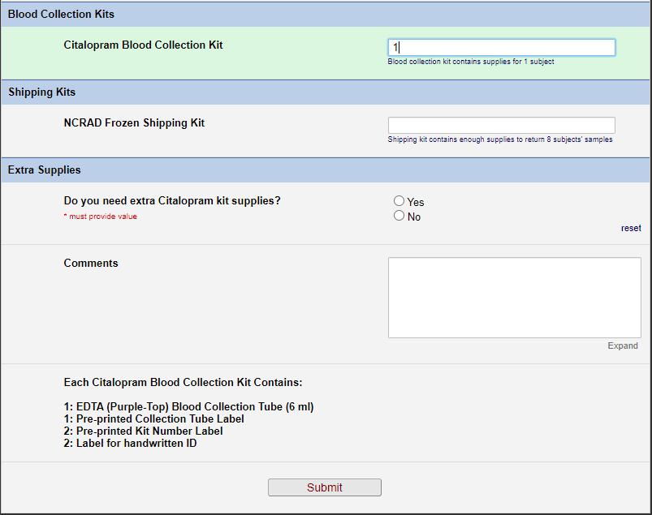
Indicate the quantity needed of each kit
Once selected, kit components of the chosen kit will appear at the bottom of the screen
Click “Submit” to turn in your request.
**Note: You can order more than one type of kit in a single kit request**

Slide 9
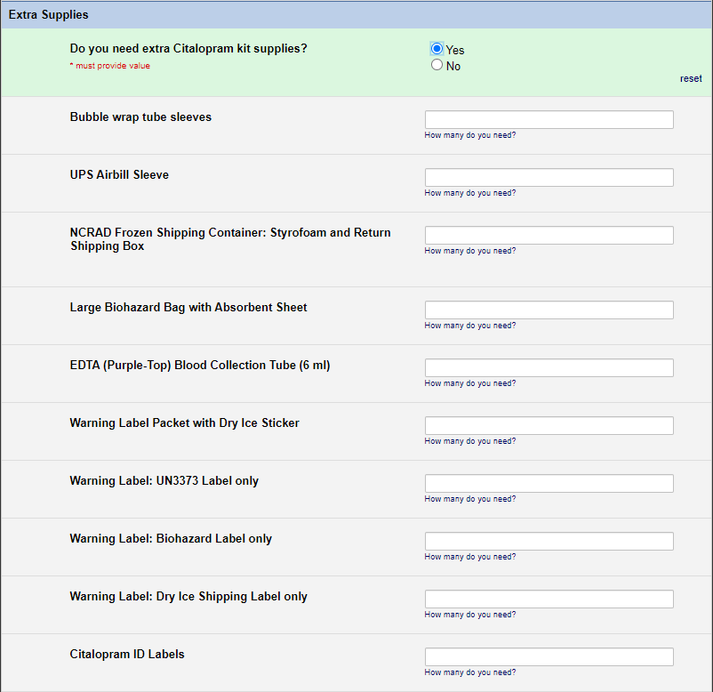

Slide 10
Specimen Labels

Slide 11
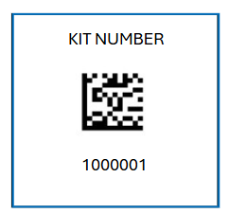
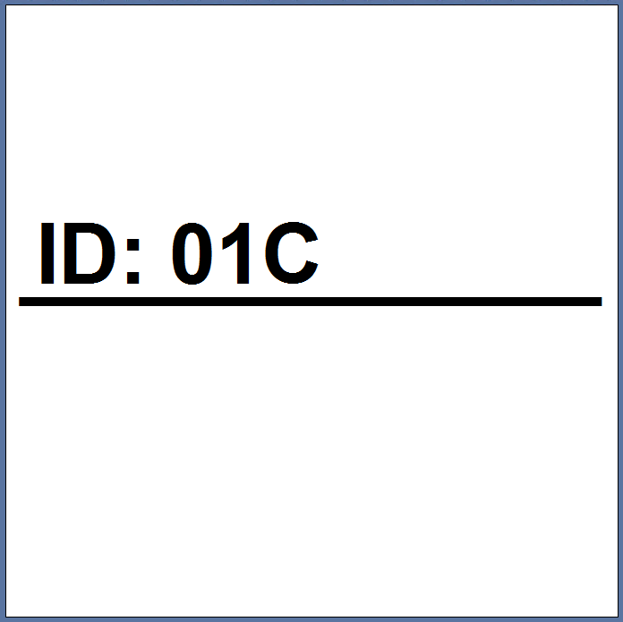
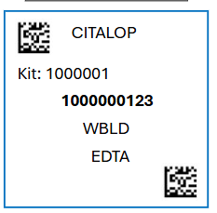

Three Label Types
Kit Number
ID
Collection Tube

Slide 12
Kit Number Labels
Used to track patient samples and provide quality assurance – Will be placed on the following locations :
  Blood Sample and Shipment Notification Forms
  One extra label provided
  Provided by NCRAD in the kits

Slide 13
ID Labels
Subjects will be identified by their Citalopram Study ID
Sites will be responsible for handwriting this onto the provided labels
  Must use Fine Point Permanent Marker

Slide 14
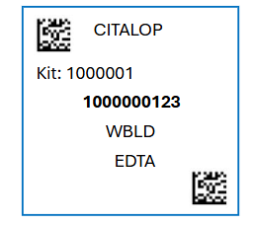
Collection Tube Labels
Collection Tube labels have 5 components:
  10 digit specimen barcode
  Study name
  Specimen type
  Kit number
  2 QR Codes

Slide 15
Blood Collection Tubes
Label 1: ID label
Label 2: Collection Tube label
All collection tubes will have two labels:
  The handwritten ID label
  The collection tube label

Slide 16
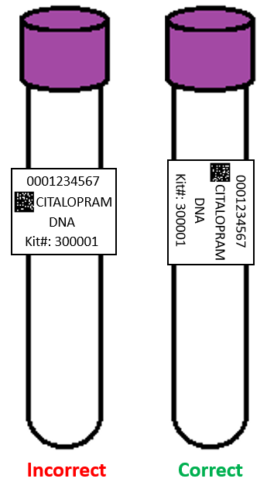
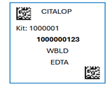
Labeling Biologic Samples
Label all collection tubes before cooling, collecting, processing or freezing samples
Label only 1 subject’s tubes at a time to avoid mix-ups
Wrap the label around the tube horizontally. Label position is important for all tube types
Make sure the label is completely adhered by rolling between your fingers

Slide 17
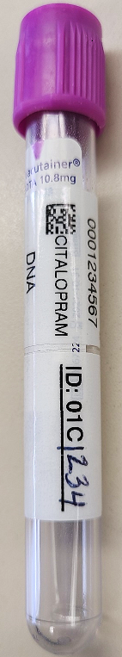
Collection Tube Labeling
Collection Tube Label
Site and PTID Label
EDTA Tube

Slide 18
Handling/Processing
Study Specimens

Slide 19

Blood Draw Order
Tube Type | Number of Tubes Drawn | Tube Image
EDTA (Purple-Top) Tube (6 ml) | x1

Slide 20
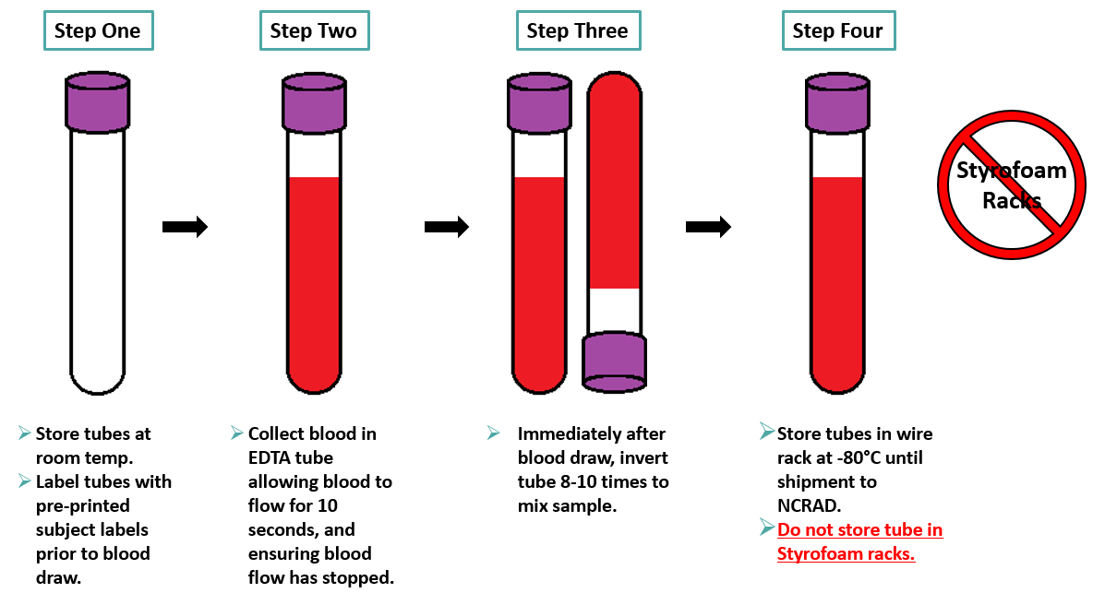
Whole Blood Collection

Slide 21
Sample Shipments

Slide 22
Sample Shipment Summary
Collection Tube | Drawn At | Shipping Temperature
1 EDTA (Purple-Top) Blood Collection Tubes (6 ml) | Baseline Visit | Frozen

Slide 23
Frozen Shipment Packaging
Samples shipped frozen to NCRAD
  Ship Monday-Wednesday Only
Hold packaged samples in a -80°C freezer until pickup
Include copy of Blood Sample Shipment and Notification Form
Batch samples together
  8 samples in each shipment
  Batch shipping should be performed as a full shipment of specimens accumulates

Slide 24
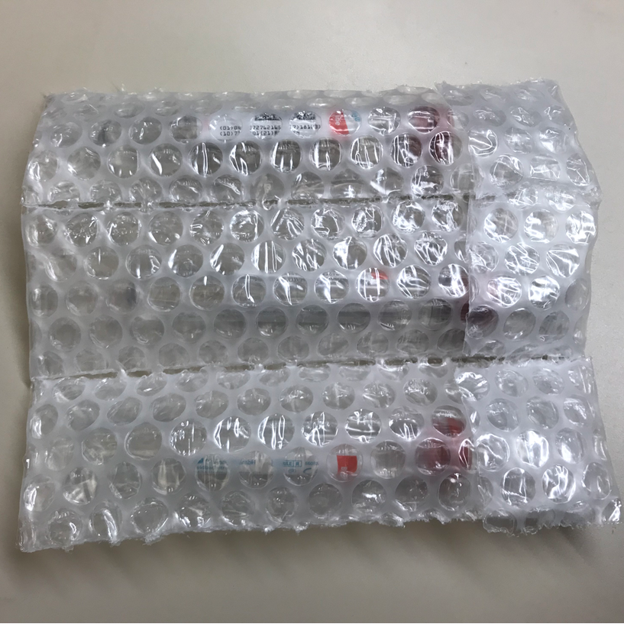
Frozen Shipment Packaging
Place 8 EDTAs into bubble sleeves
Put bubble sleeves into large biohazard bag

Slide 25
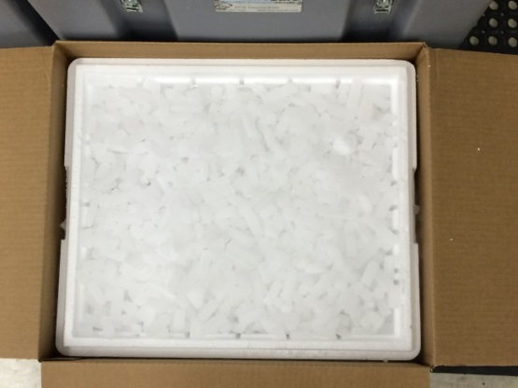
Frozen Shipment Packaging
Place 2-3 inches of dry ice in the bottom of the Styrofoam shipping container, then insert the samples.
Fully cover the samples with about 2 inches of dry ice in the provided shipper.
Each Styrofoam shipper must contain about 10 lbs (4.5 kg) of dry ice.

Slide 26
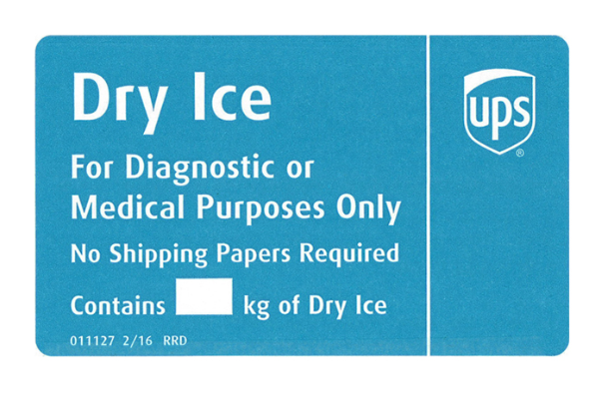
Frozen Shipping – Dry Ice Requirements
Dry Ice label should not be covered with other stickers and must be completed or the shipping carrier will reject/return your package!
Net weight of dry ice in kg
4.5

Slide 27
Blood Sample and Shipment Notification Form
A copy of the sample form must be emailed or faxed to NCRAD prior to the date of sample arrival.
Please include sample forms in all shipments of frozen and ambient samples.
Email: alzstudy@iu.edu

Slide 28
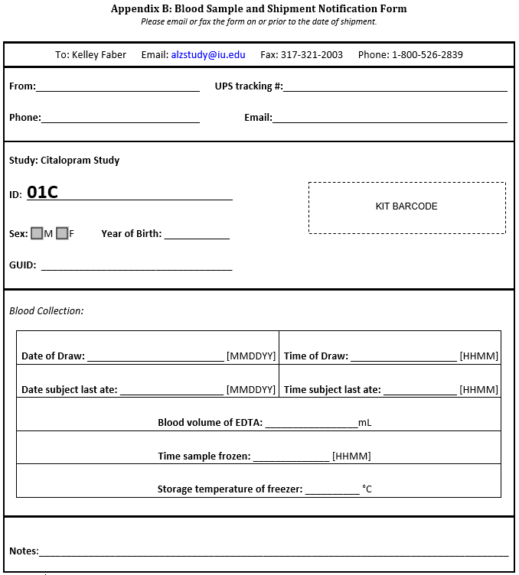

Slide 29
UPS ShipExec Thin Client Training for New Users

Slide 30
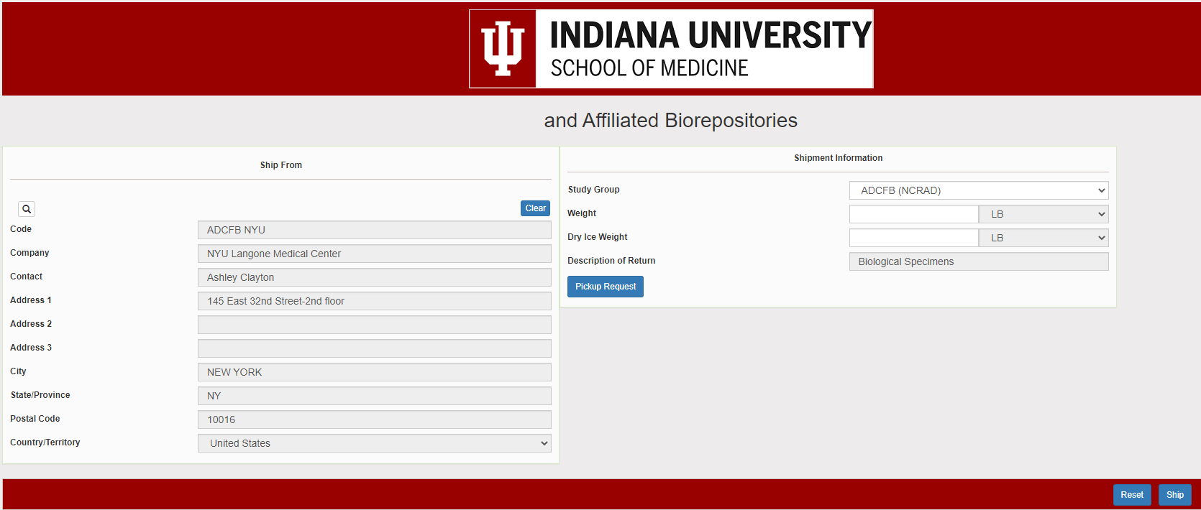

Slide 31
User Access
NCRAD will register user
  Username: user’s email address
  Password: NCRAD creates first default password, user can then update upon first login

Slide 32

Accessing Shipping Client
Log into the ShipExec Thin Client: https://kits.iu.edu/UPS
Click on the “Shipping” dropdown and click on “Shipping and Rating”

Slide 33
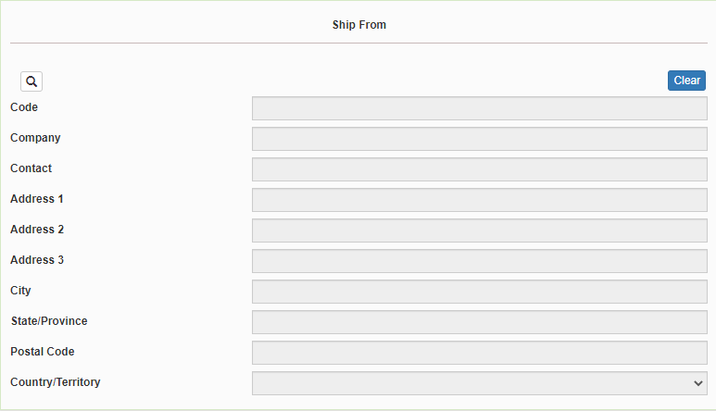
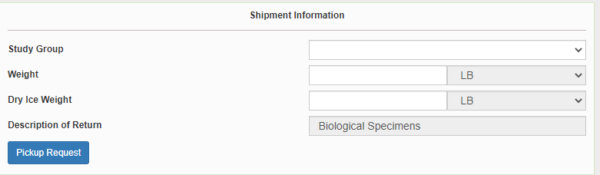
Finding Your Contact Information
On the right side of the screen, choose the name of your study from the “Study Group” drop down menu
  This step must be done 1st
On the left side of the screen, Click on the magnifying glass icon

Slide 34
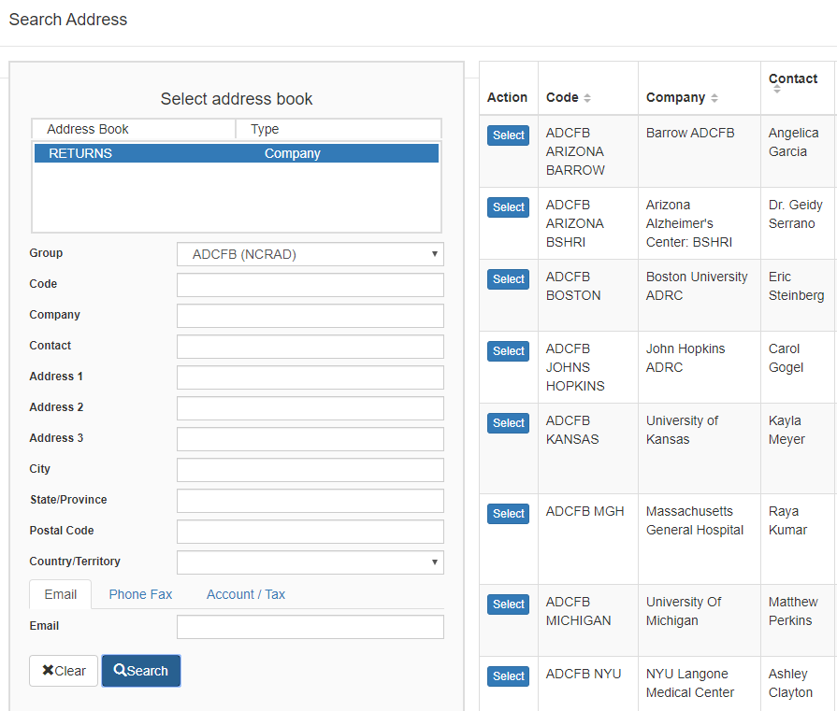
Finding Your Contact Information
On the right side of the screen, a list of all the site addresses within the study you selected should populate
User can filter the search for their address further by filling in the “Company”, “Contact”, or “Address 1” fields
Hit “Search” when ready.
Once you have found your site address, click on the “Select” button to the left of the address
If any information needs to be updated, please reach out to the NCRAD Coordinator of your study

Slide 35
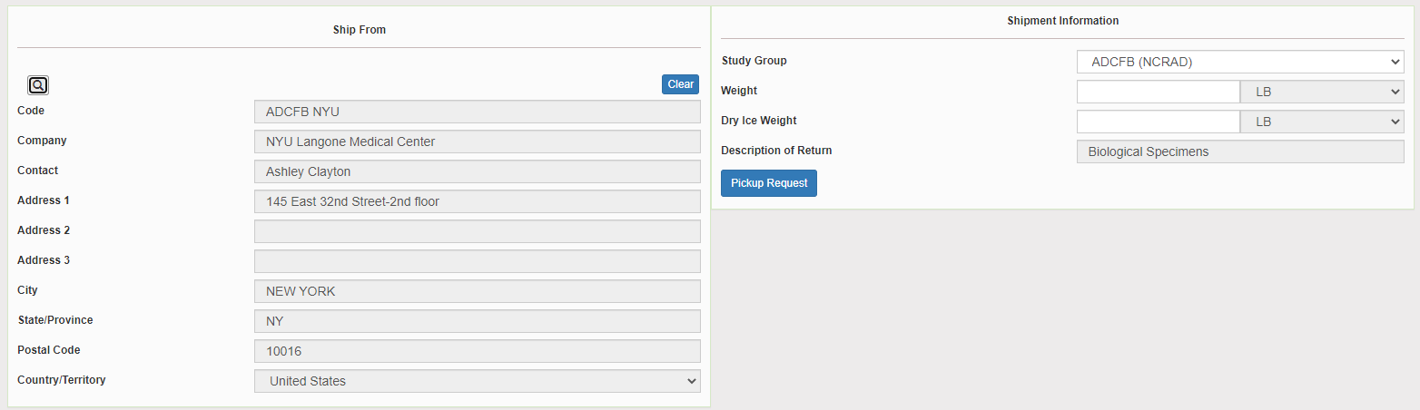
Verify Information
Please verify that both the shipping information AND study reference are correct for this shipment

Slide 36
Selected wrong Contact or Study Reference?
Click Reset and repeat previous search steps

Slide 37
Entering Shipment Information
  Frozen shipments
    Enter the total weight of your package in the “Weight” field
    Enter the dry ice weight in the “Dry Ice Weight” field
      The “Dry Ice Weight” field cannot be higher than the “Weight” field (will receive an error message)

Slide 38
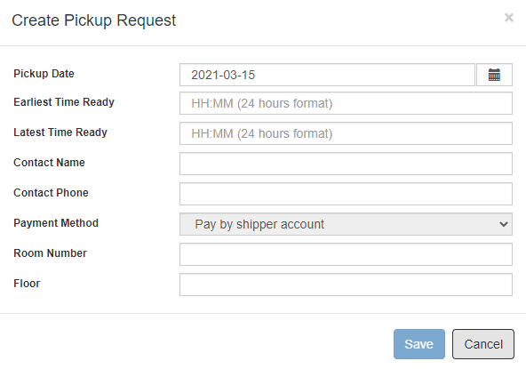
Need to request UPS Pickup?
Click on the “Pickup Request” button
Fill out all fields for the pickup request
Enter in the “Earliest Time Ready” and “Latest Time Ready” in 24-hour format
  Users must schedule pickup minimum 1 hour before “Earliest Time Ready”
Choose a name and number that is the best to contact if the UPS driver has questions related to picking up your package
Entering the Room Number and Floor will help the UPS driver locate your package
  Room number field is free text
  Floor field is numerical only
Hit “Save” when done

Slide 39
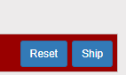
Shipping Packages
If all fields in “Ship From” and “Shipment Information” fields are completed, and pickup request is completed (if necessary), click Ship in the bottom right corner of the page

Slide 40
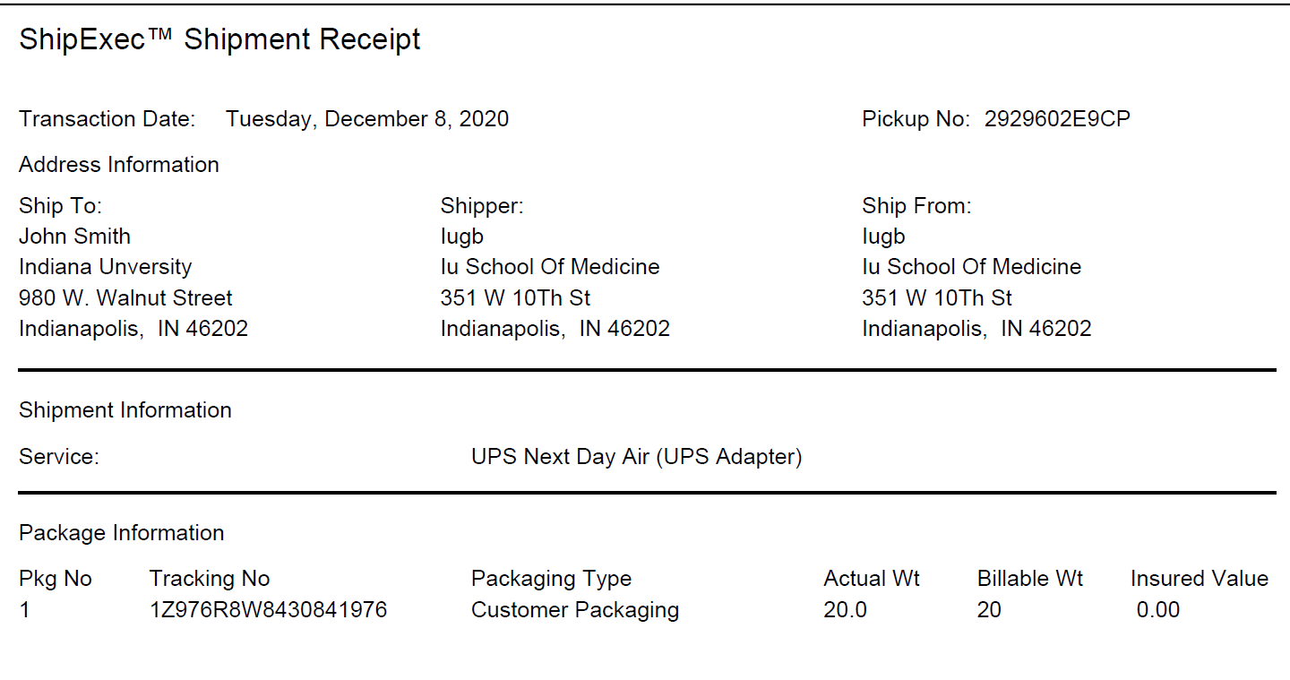
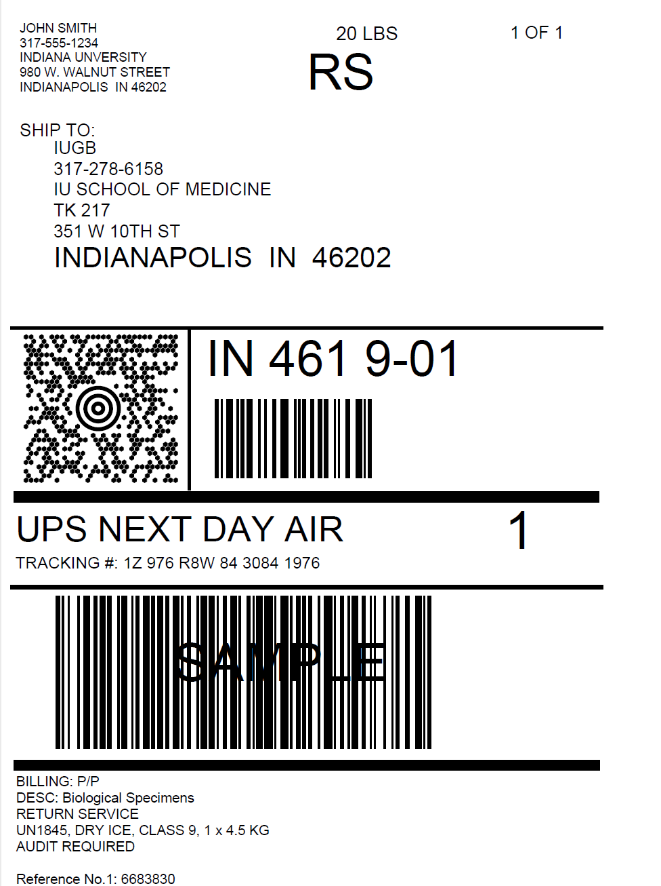
Accessing Airbill
Two PDF files will download to your computer after you click “Ship”:
Shipment Receipt
Airbill
“Pickup No.” field will populate if Pickup Request is submitted
  The “Pickup No:” is the reference number to your specific pickup request in case there are any issues with your package being picked up by UPS
Check Pickup Status by going to UPS.com, click on the Shipping, select Schedule a Pickup, and look on the right side of screen to click on “Pickup Request Status”. Enter in the Pickup No. listed on receipt into PRN field and submit

Slide 41
Accessing Airbill
Print out the UPS air waybill
Fold the UPS air waybill and slide it inside the plastic UPS sleeve (NCRAD will provide these in kit requests)
Peel the back off the plastic UPS sleeve and stick the sleeve to your package, making sure it is laying as flat as possible along the surface of the package.

Slide 42

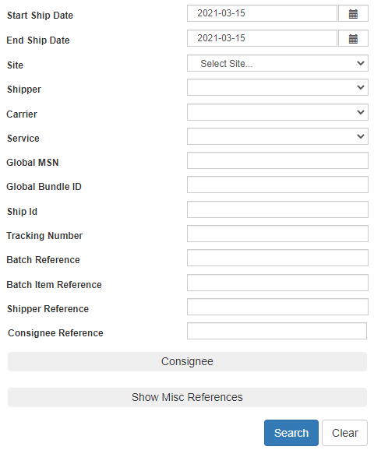
Reprint Airbills/Voiding Shipments
To reprint airbill or void a shipment, click “History” at the top of the ShipExec Thin Client portal
If your shipment doesn’t automatically pop up, enter in the date of shipment and then click “Search”

Slide 43
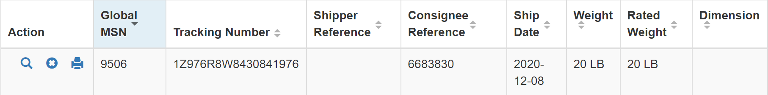
Reprint Airbill
Click the print icon to reprint airbill

Slide 44
Void Shipment
To void a shipment, click on the “X” symbol

Slide 45
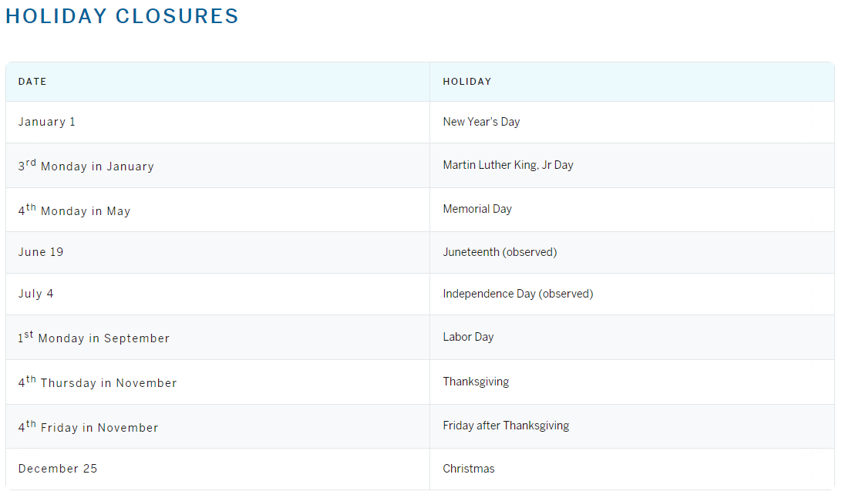
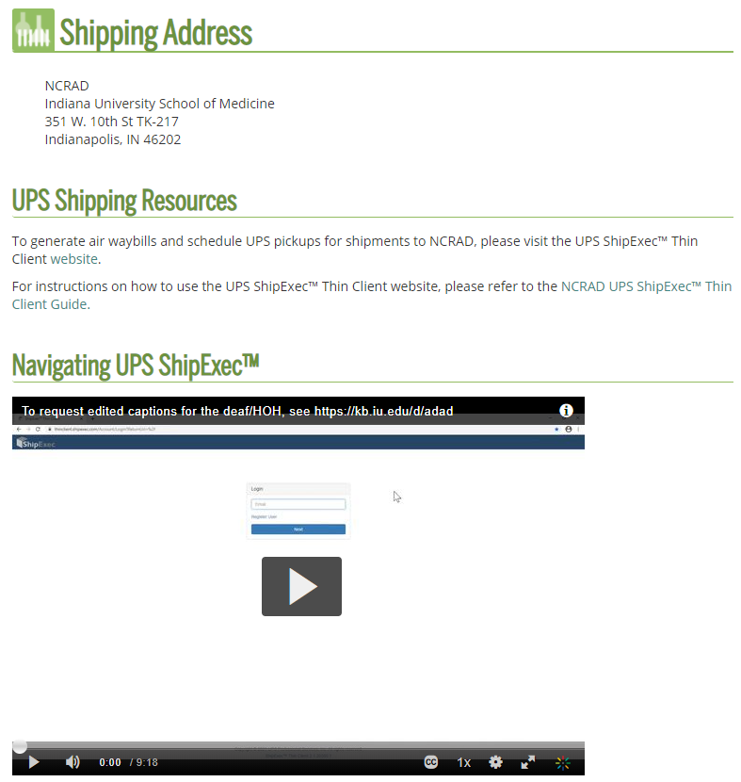
NCRAD Website: Helpful Pages
https://ncrad.org/contact/holiday-closures
https://ncrad.org/contact/shipping-resources

Slide 46
Nonconformance Issues
Recommendation:
Place in tube rack in freezer upright until shipment
Samples frozen at an angle/inverted
Fields left blank on Blood Sample and Shipment Notification Form
Last time subject ate often left blank/unknown
Incorrect data reported on Sample and Shipment Notification Forms
Recommendation: Complete Sample Notification forms during the participant study visit as samples are processed.

Slide 47
Nonconformance Issues
Samples arriving to NCRAD without labels
Sample forms not faxed or scanned to NCRAD the day before shipment
Recommendation:
Do not throw away labels until samples are packed and shipped.
Ship Samples to NCRAD utilizing the Notification Form.

Slide 48
Contact Information
  Ronae Williams
    Phone: (317) 278-9082
    E-mail: rdw2@iu.edu
  General NCRAD Contact
    Phone: (800) 526-2839
    E-mail: alzstudy@iu.edu
    Website: www.ncrad.iu.edu

