Slide 1
Preventing Alzheimer’s
Disease with Cognitive Training:
The PACT Trial
Biospecimen Collection and Shipment training

Slide 2
Training Overview
Study Specimen Collection Overview
NCRAD Kit Request Module
Specimen Labeling Instruction
Specimen Collection and Processing
Specimen Packaging and Shipment Instruction
Creating Airbills and Scheduling Pickups
Non-Conformance Issues
NCRAD Website and Contact Information

Slide 3
PACT Specimen Collection
Samples will be collected and processed during Baseline Visit and Final Clinical Evaluation.
Plasma and Buffy Coat will be frozen and shipped to NCRAD for both visits
Specimen Type | All Visits
Plasma | X
Buffy Coat (DNA) | X

Slide 4
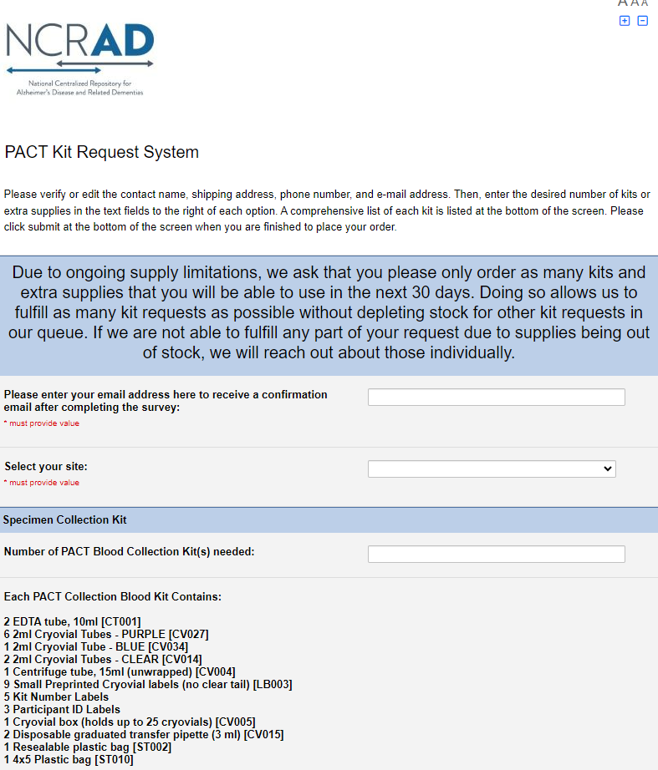
Kit Request Module
kits.iu.edu/PACT
Ordering blood kit supplies
Ordering frozen specimen shipment supplies
Please allow three weeks for orders to be processed and shipped

Slide 5
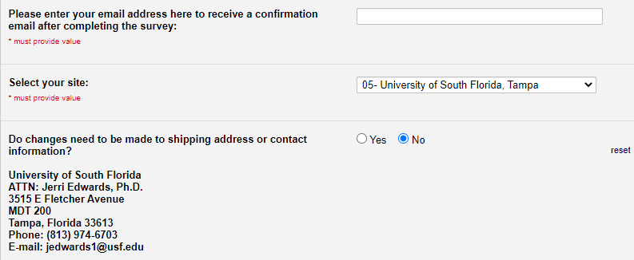
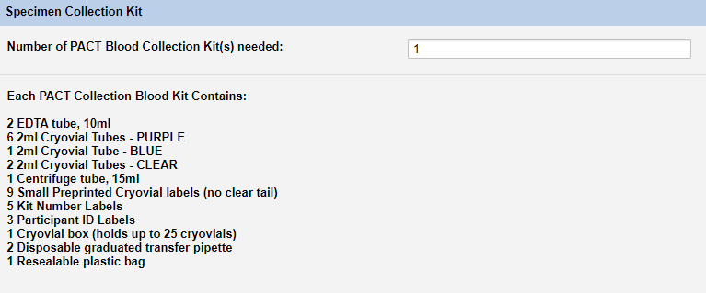
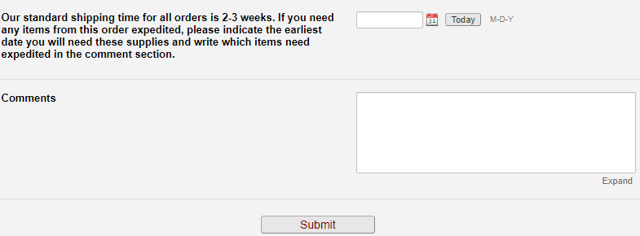
Kit Request Module Instruction
Verify site shipping address and contact information
Choose kit order amount
  Specimen Collection Kit
  Frozen Shipping Supply Kit
  Supplemental Kit
  Extra Supplies
Rush order or special comments
*Reminder: allow three weeks for orders to be processed and delivered to your site
Notes:
Please do not order in bulk. Kits do expire. Plan for a month in advanced

Slide 6
Specimen Labeling Instruction

Slide 7
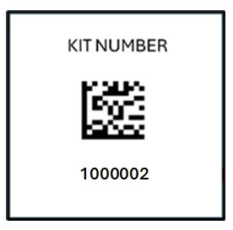
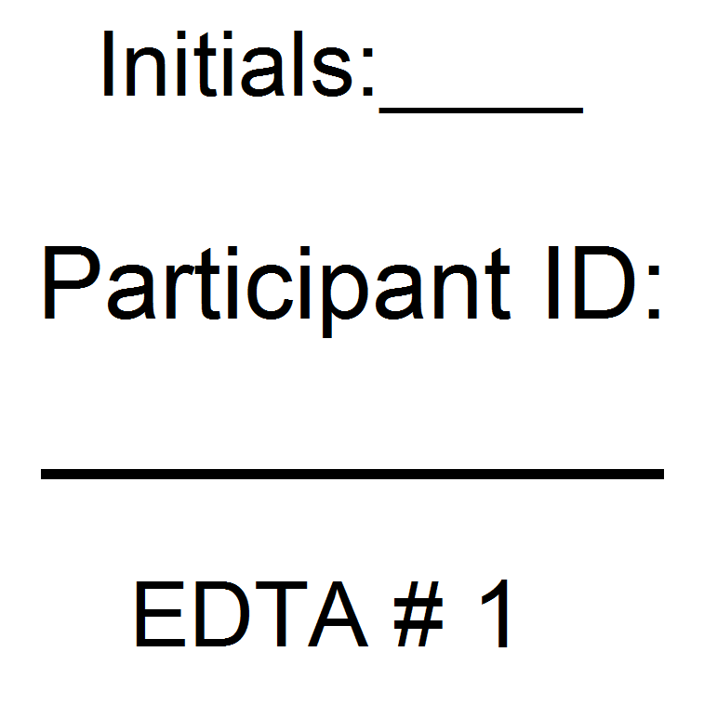
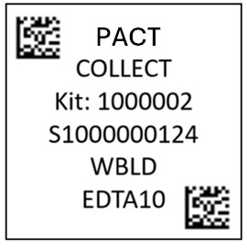
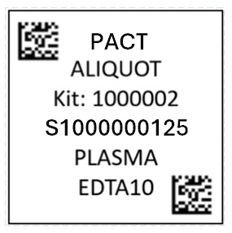
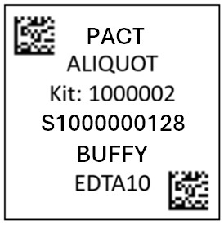
Specimen Labeling Instructions:
Label Type and Placement
Kit Number Label
Ties all visit samples and packaging together.
Must be placed on:
Blood Sample and Shipment Notification Form
Each Cryobox
Participant ID Label
Unique PACT Participant ID written by site and initials of blood processing staff
Must be placed on:
Whole-Blood 10 ml EDTA Tube (Purple-Top)
Collection Tube Label
Contains Specimen Number, Specimen Type, and Kit Number.
Must be placed on:
Whole-Blood 10 ml EDTA Tube (Purple-Top)
Aliquot Cryovial Label
Contains Specimen Number, Specimen Type, and Kit Number.
Must be placed on:
Aliquoted 2 ml cryovial with corresponding aliquot type

Slide 8
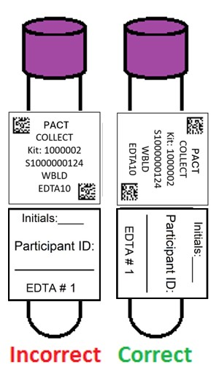
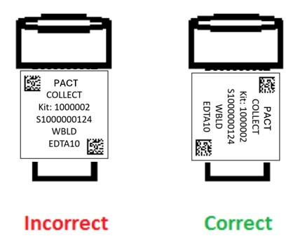
Specimen Labeling Instruction:
Label Placement Details
Write participant ID and initials with fine-point marker prior to label placement
Place all labels on Whole-Blood EDTA 10 ml tube and Cryovial 2 ml before blood collection, processing, or freezing
Label collection tubes and cryovials for one subject at a time in order to avoid mix ups.
Wrap labels horizontally and adhere completely to all tubes
Collection Tube Labeling
Cryovial
Labeling

Slide 9
Specimen Collection and Processing

Slide 10
Specimen Collection and Processing:
Specimen Tube Types
Type | Cap Color | Size | Purpose | Amount
EDTA Tube | Purple | 10 ml | Whole blood collection | 2
Conical Tube | Orange | 15 ml | Pooling plasma from EDTA tubes | 1
Cryovial | Lavender | 2 ml | 1.5 ml aliquots of plasma from conical tube | Up to 7
Cryovial | Blue | 2 ml | Aliquot residual plasma <1.5 ml after filling lavender top cryovials | 1
Cryovial | Clear | 2 ml | ~1.0 ml aliquots of buffy coat from EDTA tubes | 2
Notes:
You do not have to use all 7 lavender top cryovials. Fill each lavender top cryovial individuals to 1.5 ml and place the remaining plasma into blue top cryovial. Ex: 5 1.5 lavender .5 blue

Slide 11
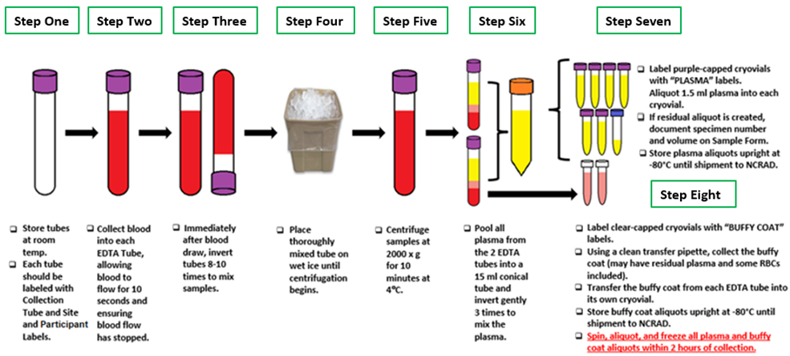
Specimen Collection and Processing:
Blood Collection and Specimen Processing

Slide 12
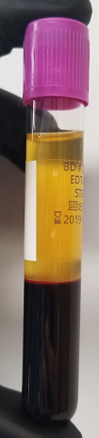
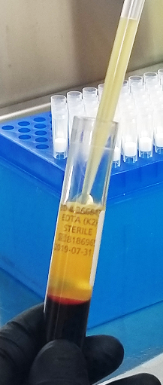
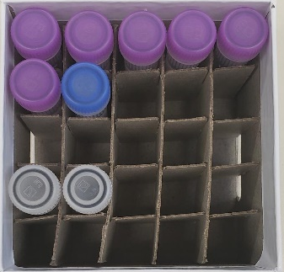
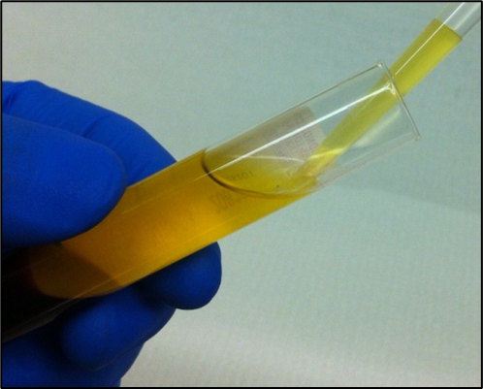
Specimen Collection and Processing:
Plasma Collection
Processed plasma creates up to seven
1.5 ml aliquots in lavender-top cryovials
Residual plasma is placed in blue-top cryovial
10 ml EDTA tubes after centrifuge
15 ml conical after inversion

Slide 13
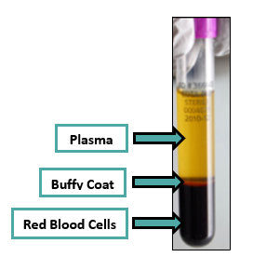
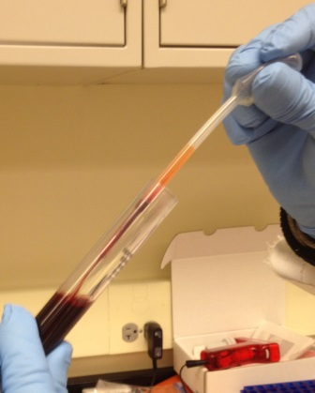
Specimen Collection and Processing:
Buffy Coat Collection
Buffy Coat
Aliquot ~1.0 buffy coat into two clear-capped cryovials
The buffy coat aliquot is expected to have a reddish color from the RBCs

Slide 14
Important Note
If there are any unused cryovials, please do not send the empty cryovials to NCRAD.
Our lab charges the study for the destruction of these empty tubes.
These unused cryovials (ensure labels are removed) can be saved as part of a supplemental supply at your site or the cryovials can be disposed of per your site’s requirements.

Slide 15
Specimen Packaging, Labeling & Forms

Slide 16
Frozen Shipment Packaging
All samples shipped frozen to NCRAD Monday-Wednesday ONLY
Hold packaged samples in a -80°C freezer until pickup
Include copy of Blood Sample Shipment and Notification Form
Batch samples together (8 cryoboxes)

Slide 17
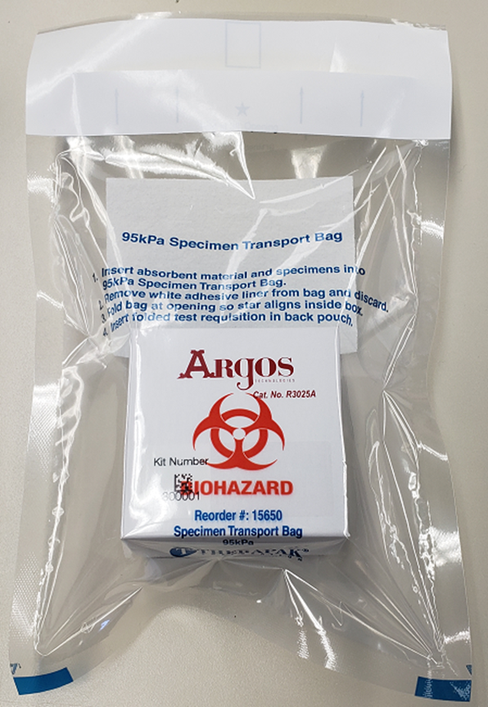
Specimen Packaging and Shipment:
Frozen Specimen Packaging
Step 1. Place frozen cryobox in biohazard bag with absorbent sheet
Important: Confirm kit number label has been placed on the outside of cryobox
Each Styrofoam shipper can contain up to 8 cryoboxes

Slide 18
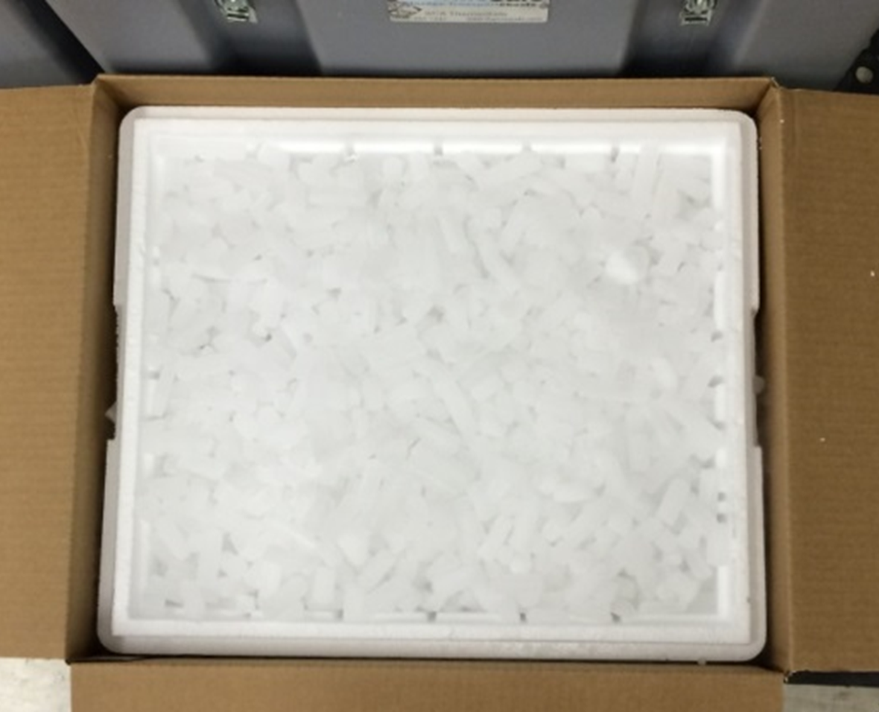
Specimen Packaging and Shipment:
Frozen Specimen Packaging
Step 2. Place 2-3 inches of pelleted dry ice in the bottom of the styrofoam shipping container
Step 3. Insert up to 8 cryoboxes with tubes laying upright
Step 4. Fully cover all cryoboxes with 2 inches of pelleted dry ice
Step 5. Place Styrofoam shipping container into cardboard shipping container
Notes:
If samples freeze at an angle or upside down it ruins the quality of the sample.

Slide 19
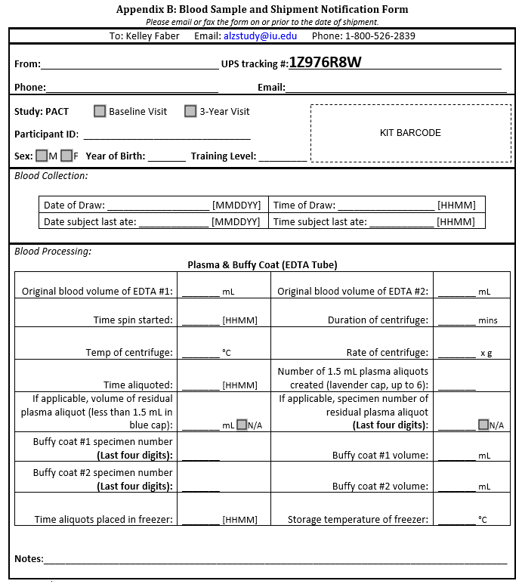
Blood Sample and Shipment Notification Form
Step 6:
Complete and send Blood Sample & Shipment Notification Form for each participant in Large Cardboard Shipper
Fill out completely during study visit
Include Kit Number Label on Form
Make a copy of each form prior to shipment.
Include physical copies of forms in shipper.
Notes:
You will need one physical form included in shipment and also send an electronic copy to us before your package goes out. If there are 8 cryboxes, we should receive 8 of these forms.

Slide 20
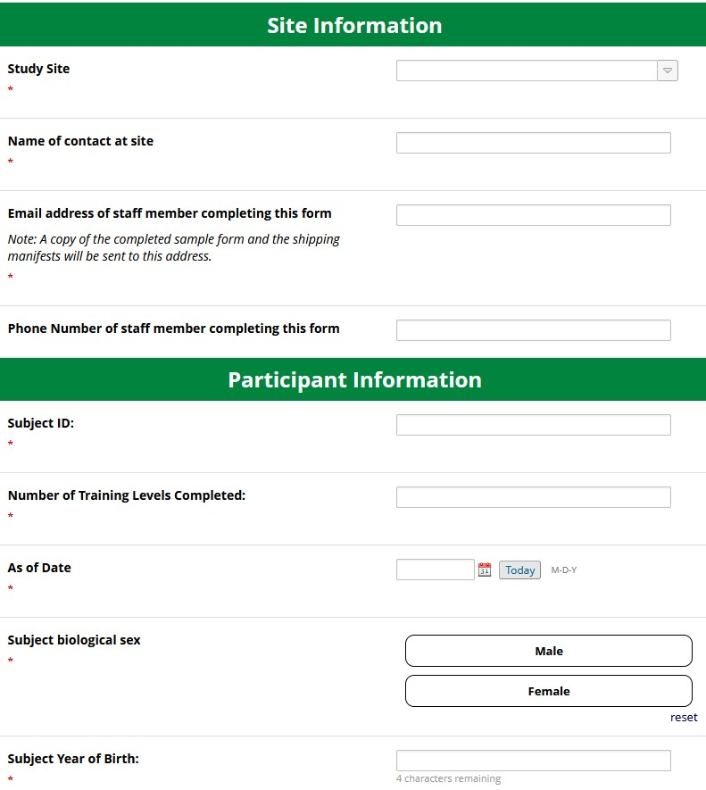
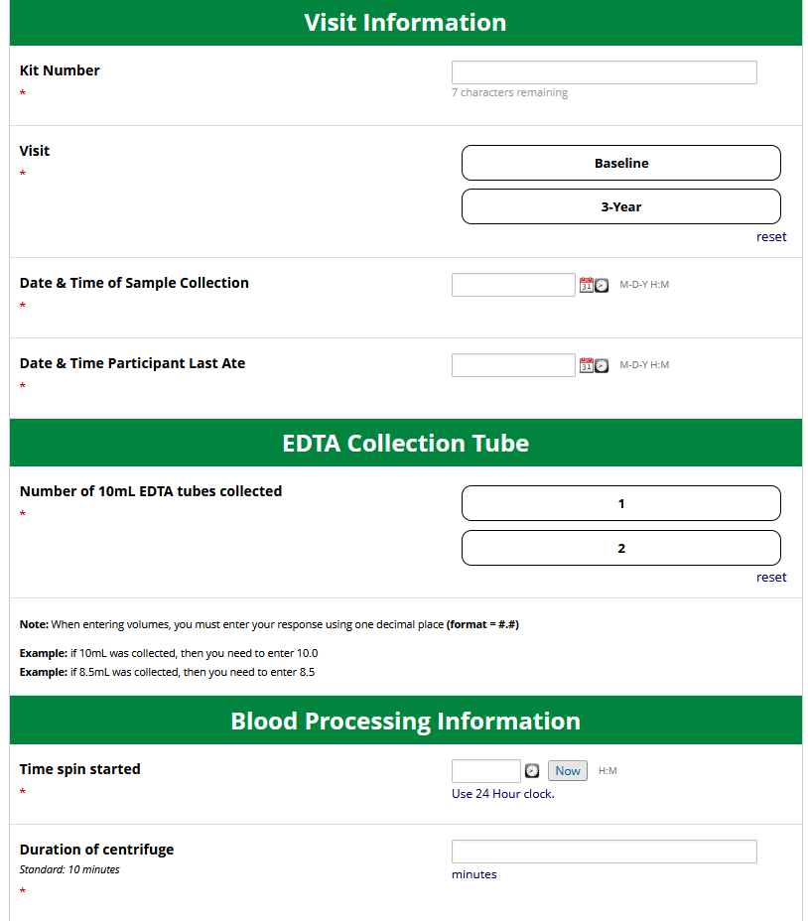
Sample Processing Electronic Data Capture Submission
Step 7: Complete electronic sample form. Click here: https://redcap.link/PACTSampleForm
Enter appropriate site, participant, visit information and collection and processing information.
Record any protocol deviations in “Notes” section if applicable.
Click Submit.
Notes:
You will need one physical form included in shipment and also send an electronic copy to us before your package goes out. If there are 8 cryboxes, we should receive 8 of these forms.

Slide 21
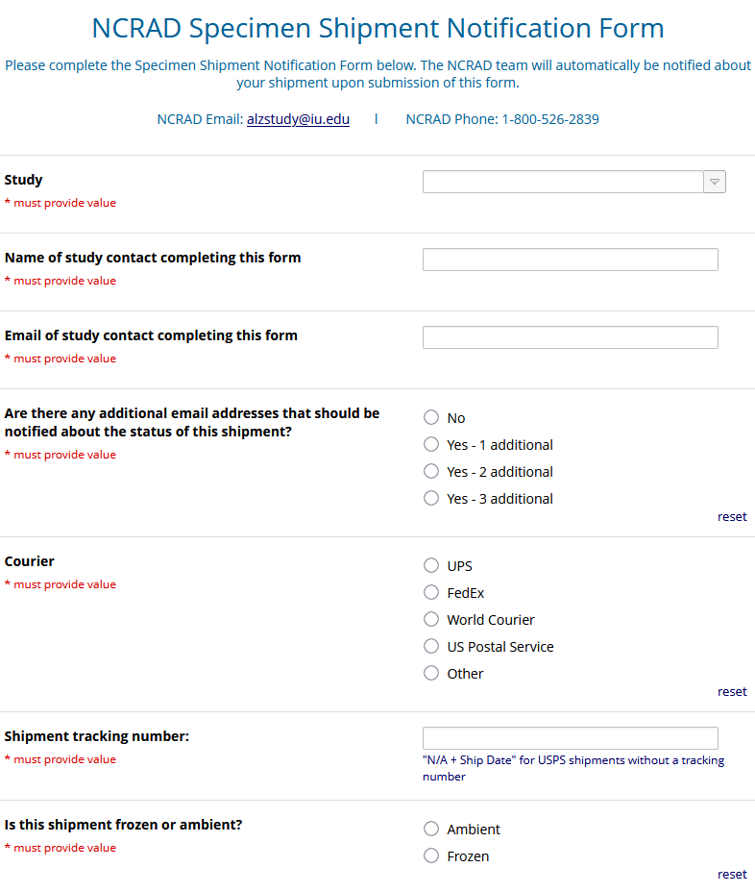
Shipment Notification Electronic Form
Step 8: Complete shipment notification form: https://redcap.link/NCRADShippingForm
Enter appropriate study, contact information, and shipping information including tracking number.
Include kit numbers and participant ID numbers for all samples in shipment.
Upload a pdf of all sample forms. If more than one form, you will have to combine them into one pdf or zip them together prior to upload.
Notes:
You will need one physical form included in shipment and also send an electronic copy to us before your package goes out. If there are 8 cryboxes, we should receive 8 of these forms.

Slide 22
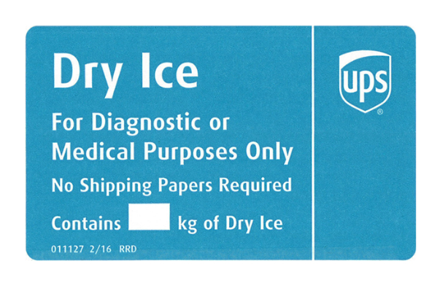
Frozen Shipping – Dry Ice Requirements
Dry Ice label should not be covered with other stickers and must be completed or the shipping carrier will reject/return your package!
Net weight of dry ice in kg
20

Slide 23
Creating Airbills/Scheduling Pickups

Slide 24

UPS ShipExecTM Thin Client Website
Log into the ShipExec Thin Client: https://kits.iu.edu/UPS
Click on the “Shipping” dropdown and click on “Shipping and Rating”

Slide 25
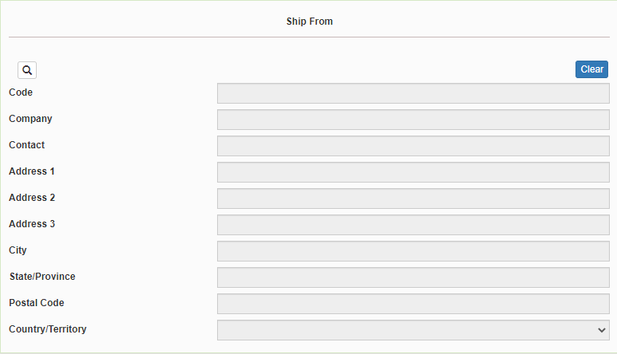
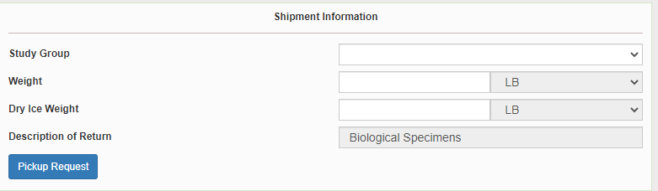
Creating Airbills & Scheduling Pick Ups:
Finding your Contact Information
On the right side of the screen, choose the name of your study from the “Study Group” drop down menu
  This step must be done 1st
On the left side of the screen, Click on the magnifying glass icon

Slide 26
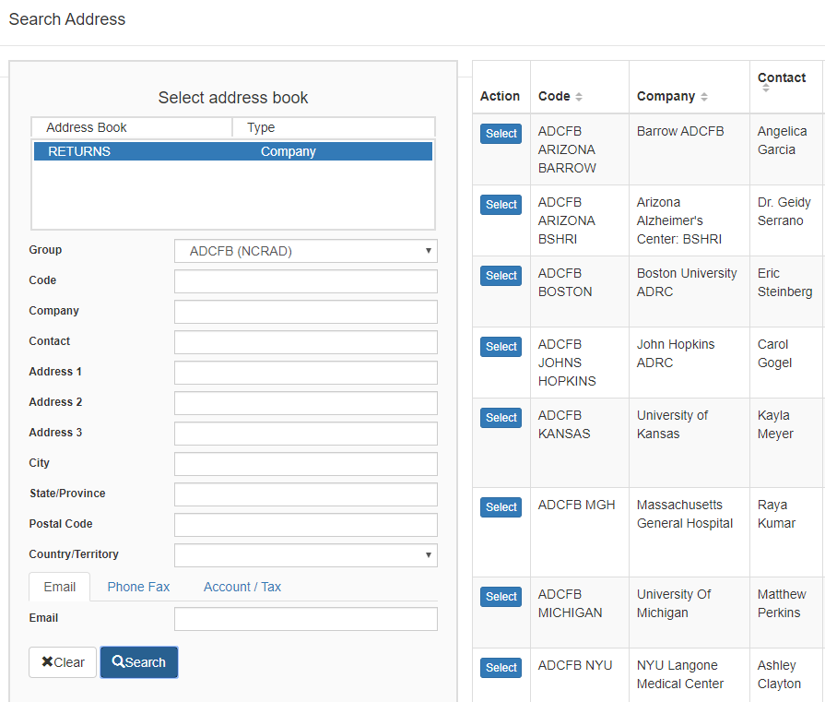
Creating Airbills & Scheduling Pick Ups:
Finding your Contact Information
On the right side of the screen, a list of all the site addresses within the study you selected should populate
User can filter the search for their address further by filling in the “Company”, “Contact”, or “Address 1” fields
Please verify that both the shipping information AND study reference are correct for this shipment
If any information needs to be updated, please reach out to the NCRAD Coordinator of your study

Slide 27
Creating Airbills & Scheduling Pick Ups:
Entering Shipment Information
    Enter the total weight of your package in the “Weight” field
    Enter the dry ice weight in the “Dry Ice Weight” field
      The “Dry Ice Weight” field cannot be higher than the “Weight” field (will receive an error message)

Slide 28
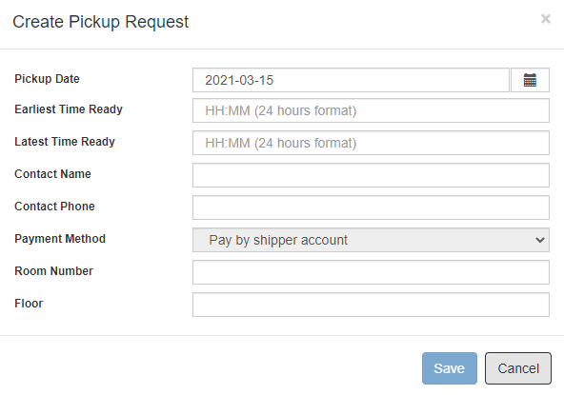
Creating Airbills & Scheduling Pick Ups:
Scheduling Pickup Request
Click on the “Pickup Request” button
Fill out all fields for the pickup request
Enter in the “Earliest Time Ready” and “Latest Time Ready” in 24-hour format
Choose a name and number that is the best to contact if the UPS driver has questions related to picking up your package
Entering the Room Number and Floor will help the UPS driver locate your package
Hit “Save” when done

Slide 29
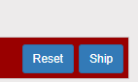
Creating Airbills & Scheduling Pick Ups:
Shipping Packages
If all fields in “Ship From” and “Shipment Information” fields are completed, and pickup request is completed (if necessary) then click “Ship” in the bottom right corner of the page

Slide 30


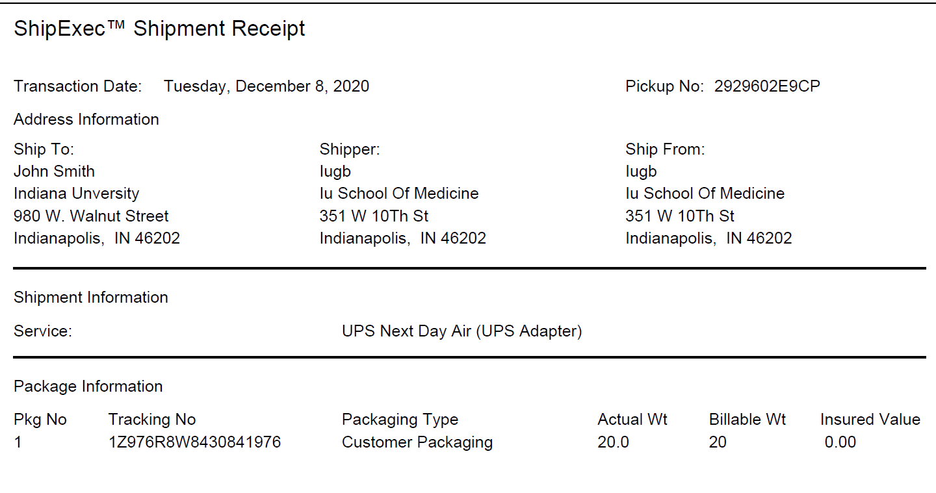
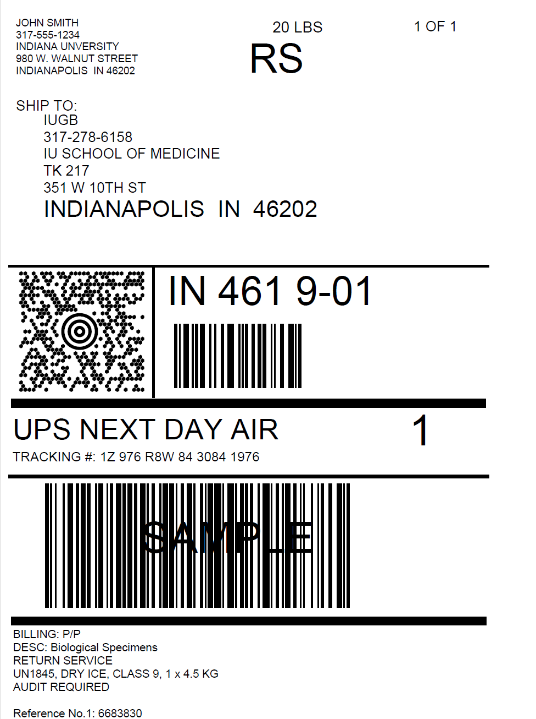
Check Pickup Status by going to UPS.com, click on the Shipping, select Schedule a Pickup, and look on the right side of screen to click on “Pickup Request Status”. Enter in the Pickup No. listed on receipt into PRN field and submit

Slide 31
Creating Airbills & Scheduling Pick Ups:
Shipping Packages
Print out the UPS air waybill
Fold the UPS Air Waybill and slide it inside the plastic UPS Sleeve (Provided by NCRAD)
Peel the back off the plastic UPS sleeve and stick the sleeve to cardboard package
  Make sure it is laying as flat as possible along the surface of the package.

Slide 32

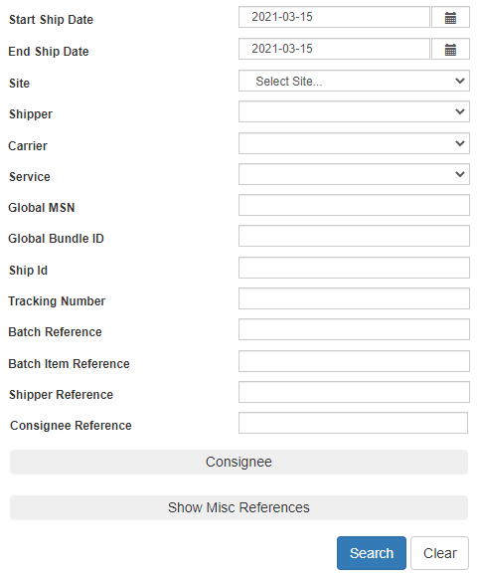
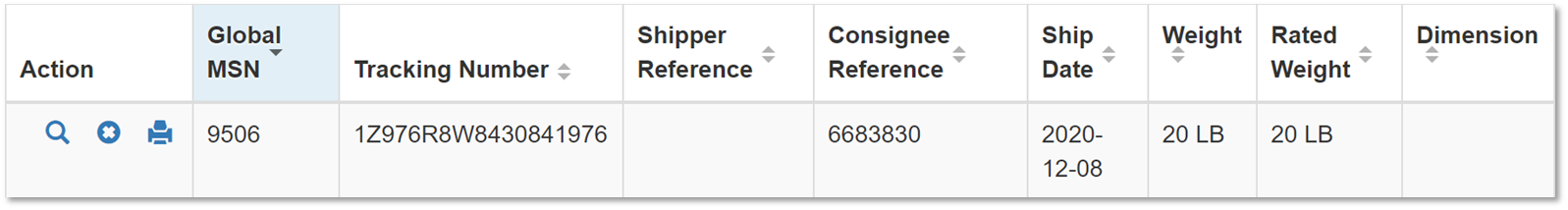
Creating Airbills & Scheduling Pick Ups:
Reprinting/Voiding Airbills
Reprint
Void
To reprint airbill or void a shipment, click “History” at the top of the ShipExec Thin Client portal
If your shipment doesn’t automatically pop up, enter in the date of shipment and then click “Search”

Slide 33
Non-Conformance Issues

Slide 34
Non-Conformance | Solution
Low volume aliquots | Put cryovials in a row, aliquoting in order until sample is depleted
Tubes received frozen at an angle/inverted | Carefully place tubes upright in freezer and in shipper
Aliquots are not labeled or labeled incorrectly | Refer to training or MOP for correct label placement. Save all labels until samples are packed for shipping.
All frozen samples for one participant are not sent within one shipment box | Keep plasma and buffy coat for individual subjects together. Use one cryobox per subject
Fields on Blood Sample and Shipment Form left blank or incorrect data is given | Complete Blood Sample and Shipment Form during participant’s study visit while samples are processed
Blood Sample and Shipment Forms are not e-mailed or faxed to NCRAD before shipment arrives | Make copy of participants completed form after visit and save until shipment.

Slide 35
NCRAD Website and Contact Information

Slide 36
NCRAD Website – PACT Page
Specimen collection overview
Link to kit request module
Online Sample Survey
MOP
Training Slides
Video Tutorials
UPS Shipping/Shipping Survey
https://ncrad.org/coordinate-studies/pact

Slide 37
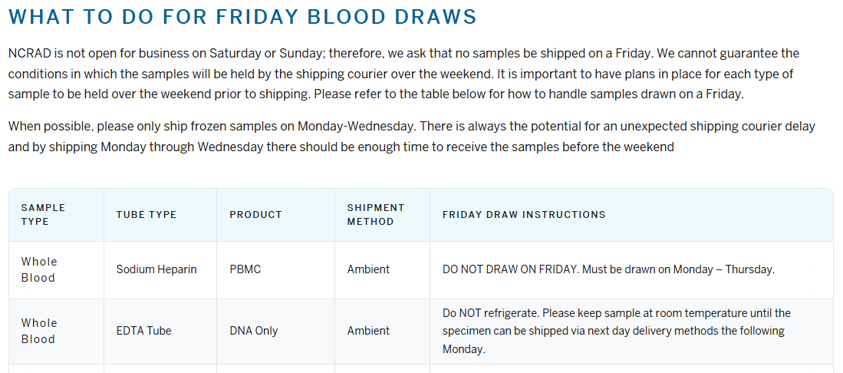
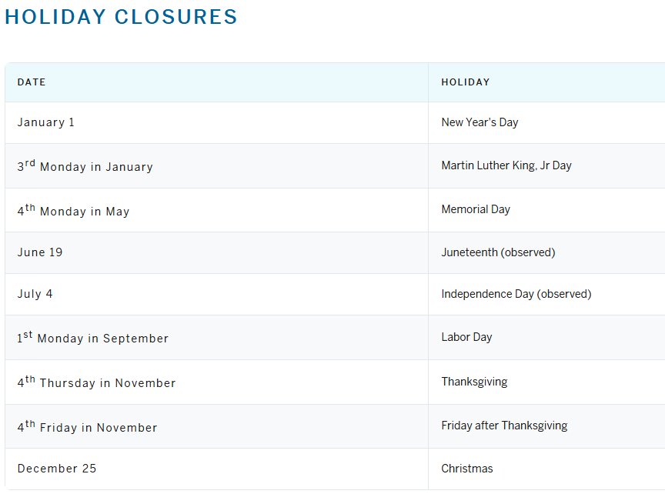
NCRAD Website – Helpful Pages
https://ncrad.org/contact/holiday-closures
https://ncrad.org/contact/friday-blood-draws
Please Note: between December 24th and January 2nd, Indiana University will be open Monday through Friday for essential operations ONLY and will re-open for normal operations on January 2nd. If at all possible, biological specimens for submission to Indiana University should NOT be collected and shipped to Indiana University after the second week of December.

Slide 38

NCRAD Contact Information
General Information
  Phone: 1-800-526-2839
  or 317-278-8413
  E-mail: alzstudy@iu.edu
  Website: ncrad.iu.edu
Jordan Glogoza – NCRAD PACT Study Coordinator
E-mail: joglogoz@iu.edu
Corinne Kim – NCRAD Project Manager
E-mail: kimcor@iu.edu

