Slide 1

SCI-PE New Coordinator Training: OHSU

Slide 2
Training Overview
Study Specimens
Kit Requests
Specimen Labels
Sample Collection and Processing
Sample and Processing Forms
Sample Shipping
Shipment Survey
NCRAD Website
FAQ
Contact Information

Slide 3
SCI-PE Study Specimens per Visit
Collection Tube | Drawn At | Specimen Type | Aliquot Volume | Total Number of Aliquots | Shipping Temperature
2 EDTA (Lavender-Top) Blood Collection Tubes (10 ml) | Week 1 & Month 24 | Plasma | 1.5 ml plasma aliquots | Up to 7 | Frozen/Ambient
 | Week 1 & Month 24 | Buffy Coat | ~1.0 ml buffy coat aliquots | Up to 2 | Frozen

Slide 4
Kit Orders
Kits Available for Order
Link to Kit Requests
Completing the Kit Request Module

Slide 5
Kit Types Available for Order
SCI-PE Kit Request Survey: https://redcap.link/SCI-PE
OHSU
  SCI-PE Week 1 Blood Kit
  SCI-PE Month 24 Blood Kit
  SCI-PE Supplemental Kit
  SCI-PE Frozen Ship Kit

Slide 6
When to Order Kits
Each site is responsible for ordering kits (labels are included) and maintaining a 1 month supply on site for scheduled participants
Please allow a minimum of 3 weeks for your order to be processed and delivered.
  Our kits are build to order and will be processed in the order received.
  Please email jazdicki@iu.edu regarding expedited orders.

Slide 7
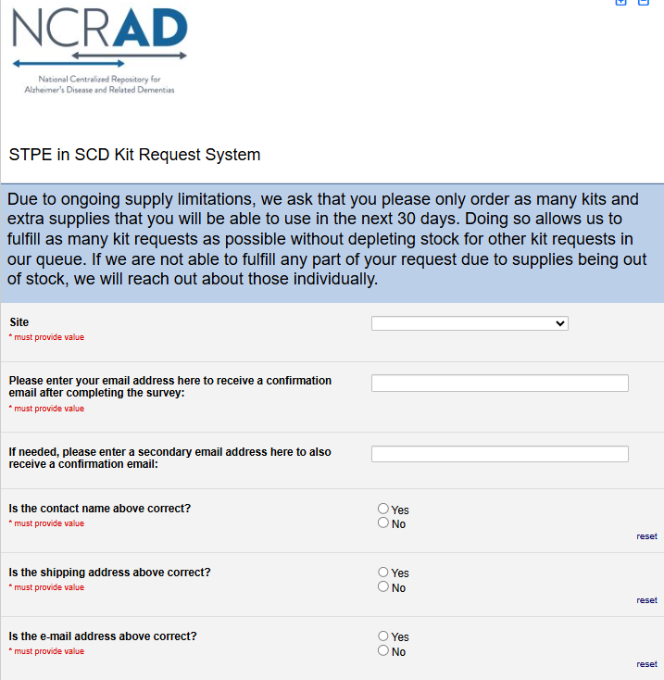
SCI-PE Kit Request Module
Choose your site from the drop-down list.
The coordinator name and contact information will appear.
  Verify that this information is accurate or correct it if necessary.

Slide 8
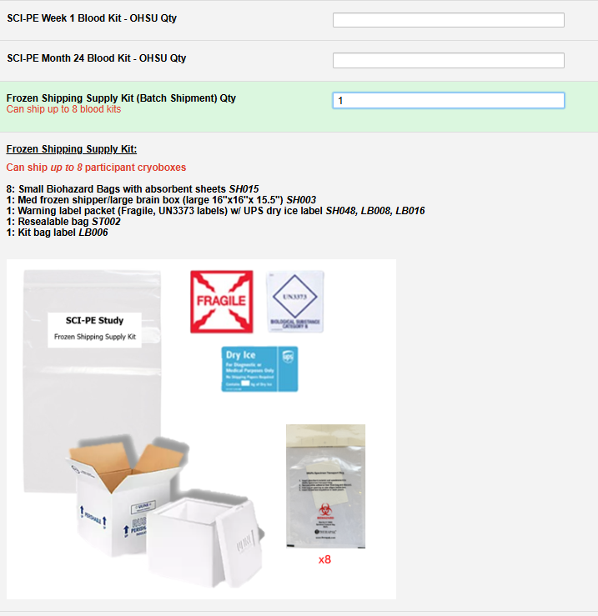
SCI-PE Kit Request Module (continued)
Indicate the quantity needed of each kit
Once selected, the kit components and pictures of the chosen kit will appear below for review
You can order more than one type of kit in a single kit request!
Important Note: Due to ongoing supply expiration issues, please limit your order to the kits/supplies you can use in the next 2 months

Slide 9
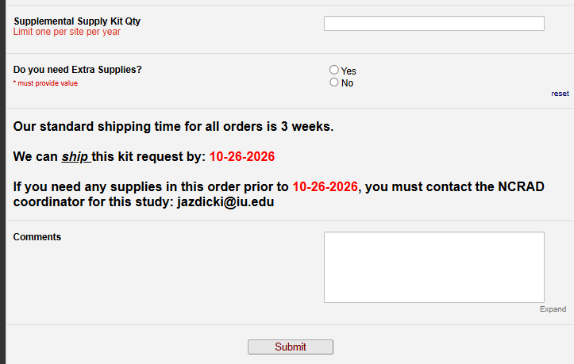
SCI-PE Kit Request Module (continued)
Each site may order 1 supplemental kit per year.
If you click Yes to “Do you need Extra Supplies” a list of supplies will populate.
  If you need a supply that is not listed, make a comment below or email NCRAD coordinator.
Important Note: The form will calculate your ship date 3 weeks from date of order. That is the date your order will be shipped by (not delivered).
If you need something sooner than this date, you must email NCRAD coordinator and specify what you need and the date needed.
Once the request is completed, click submit and you will receive an automated confirmation email of your request.

Slide 10
Specimen Labels
Types of labels provided
Labeling tubes for NCRAD lab

Slide 11
Three Label Types
Kit Number Labels​
SCI-PE ID Labels
Collection and Aliquot Tube Labels​
  Differ by specimen type

Slide 12
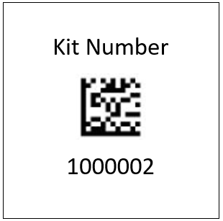
Kit Number Labels
Used to track participant samples and provide quality assurance, unique to the subject and visit
Need to be placed on the following locations:
  Outside the cryobox and biohazard bag that houses aliquots during storage and shipment
  Biological Sample and Shipment Notification Form (as needed)

Slide 13

SCI-PE ID Label
Used to identify a participant by their unique patient ID and are used to help organize collection tube labels during collection and processing.
Sites will be responsible for handwriting this onto the provided labels
  Please use a fine point marker
  Write information on label prior to adhering to tube
  Place on all collection tubes

Slide 14
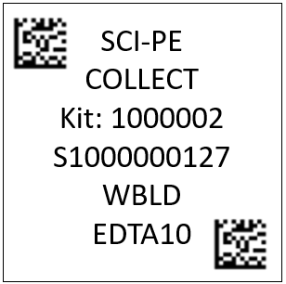
Collection and Aliquot Tube Labels
Study Name
Tube Type
Kit # (unique to the subject and visit)
Specimen Barcode (unique for each tube)
Sample Type
Collection Container
These labels are to be placed on ALL collection and aliquot tubes

Slide 15
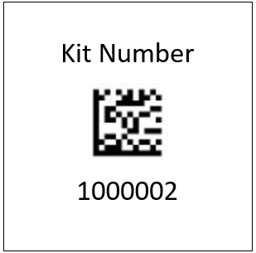
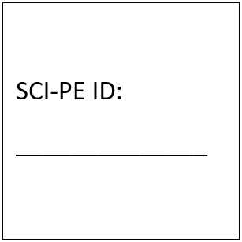

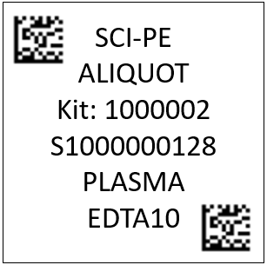
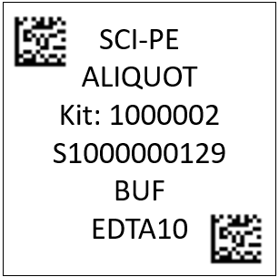
Collection and Aliquot Tube Label Example
Blood Kit Labels Examples
Collection Tube Label
Aliquot Tube Label
Aliquot Tube Label
x4
x4
x2
x7
x2

Slide 16

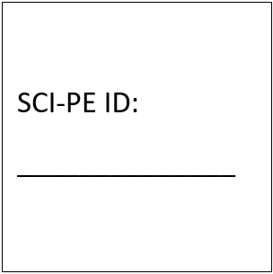
Label Placement for Blood Collection Tubes
Label all collection tubes before collecting, processing, and freezing.
Label only 1 participant’s tubes at a time to avoid mix-ups
Wrap the label around the tube horizontally. Label position is important for all tube types
Make sure the label is completely adhered with no edges coming undone
1. Collection Tube Label
Site ID: _____
RAVE #:
_____________
2. SCI-PE ID Label
INCORRECT
CORRECT

Slide 17
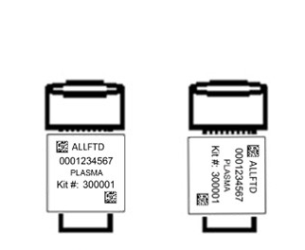
Labeling Aliquot Samples
Label all aliquot tubes before chilling, processing, and freezing samples
Label only 1 participant’s tubes at a time to avoid mix-ups
Please place the barcode near the cap
Wrap the label around the tube horizontally. Label position is important for all tube types
Make sure the label is completely adhered with no edges coming undone
INCORRECT
CORRECT
Aliquot Tube Label Diagram

Slide 18
Handling/Processing Study Specimens: Blood
Collection and Aliquoting

Slide 19
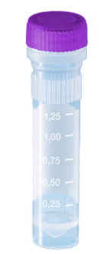
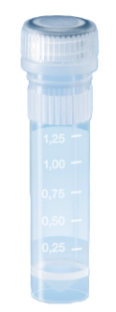
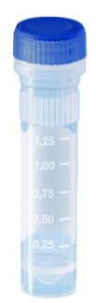
Cryovial Cap Colors
Cap Color | Sample Type | Cryovial
Lavender | Plasma (From EDTA 10mL)
Clear | Buffy Coat
Blue | Residual Plasma Aliquot

Slide 20
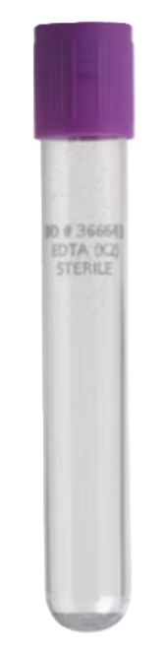



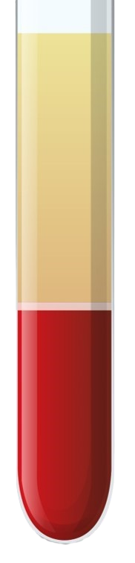


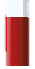
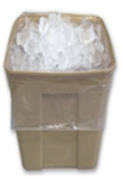



EDTA (Purple-Top) Blood Collection Tube (10 mL) for Plasma and Buffy Coat
Step 1
Step 2
Step 3
Step 4
Step 5
Step 6
Step 7
Plasma
x4
EDTA Tube
Plasma
Aliquot 1.5 mL plasma into each purple-capped cryovial.
If a residual aliquot is created, document specimen number and volume.
Using a clean pipette, transfer each buffy coat layer from each EDTA into its own clear-capped cryovial.
Store aliquots upright at -80°C until shipment to NCRAD.
Store tubes at room temperature.
Label Collection and Aliquot tubes with pre-printed labels prior to blood draw.
Collect blood in (4) 10 mL Purple-Top tubes, allowing blood to flow for 10 seconds and ensure blood flow has stopped.
Immediately after blood draw, invert tube 8-10 times to mix samples.
Place mixed EDTA tubes on wet ice until centrifugation begins.
Within 30 minutes of blood collection, centrifuge samples at 1500 x g at 4°C for 15 minutes.
Samples need to be processed and frozen within 2 hours from collection time.
Using a clean pipette, transfer plasma from all 4x 10 mL EDTA tubes into the 50 mL conical tube.
Mix the plasma by gently inverting the conical tube 3 times.
Important Note: Ensure all tubes are not expired prior to collection and processing of samples.

Slide 21
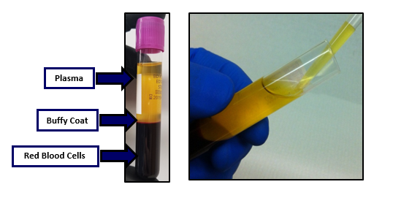
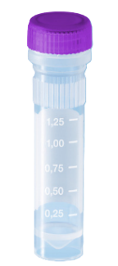
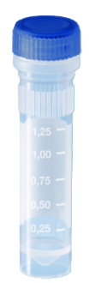
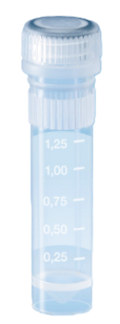
Plasma and Buffy Coat Collection
2 EDTA tubes will yield approximately 7 plasma aliquots (with 1 residual in blue cap) and 2 buffy coats (clear cap)
NCRAD tutorial: https://ncrad.org/coordinate-studies/SCI-PE

Slide 22
Sample and Processing Forms
Blood Sample Forms
Advanced Notifications

Slide 23
Digital Sample and Shipment Forms
Benefits:
Automatic digital copies provided upon submission (no more scanning forms for shipping notifications)
Ability to copy data directly from the digital forms into the EDC, reducing data entry errors
Built-in quality checks for formatting, missing fields, and inconsistent dates/times, resulting in fewer follow-up emails from NCRAD
Faster data entry turnaround, supporting inventory reporting
Reduced data entry errors, as data can be exported to Excel and imported directly into the NCRAD database

Slide 24
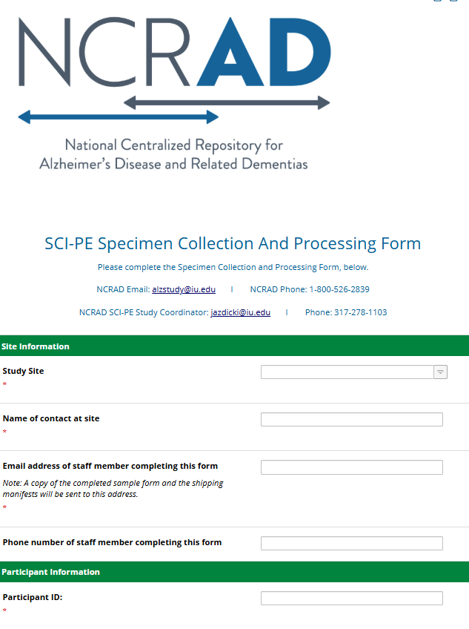
SCI-PE Sample Form
1. Go to link:
https://redcap.link/SCI-PE_Sample_Form

Slide 25
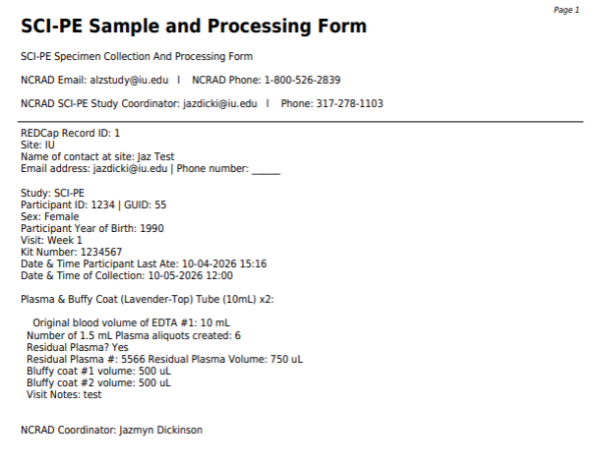
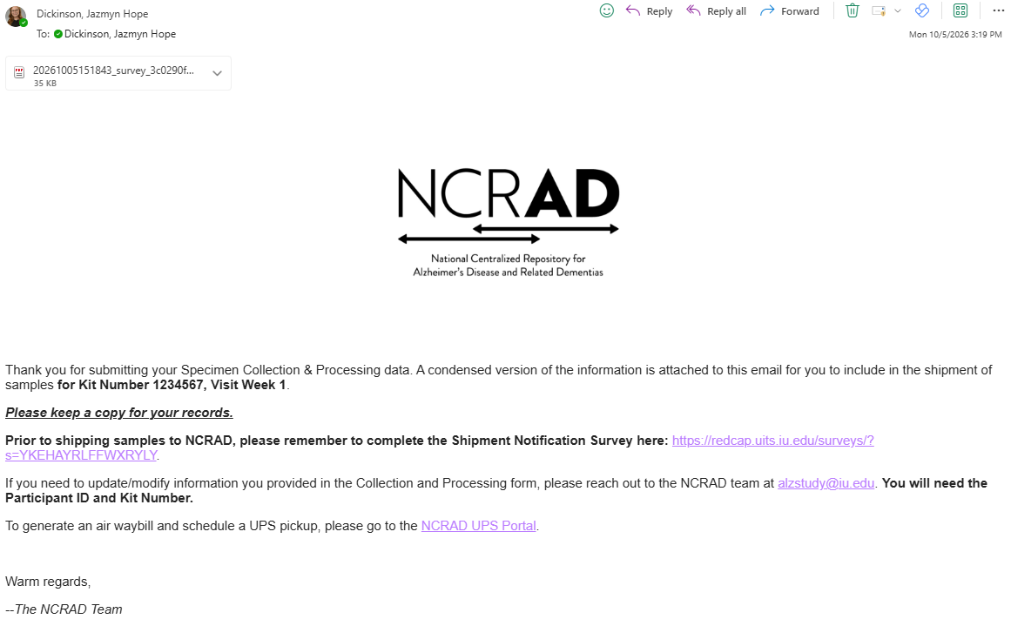
Survey Response Email

Slide 26
Sample Shipment Packaging
Preparing samples for shipment to NCRAD

Slide 27
Frozen Batch Sample Shipment
Plasma, Buffy Coat
  Ship Monday-Wednesday Only
Include copy of the Sample and Processing Form for each set of samples in shipment
Hold packaged samples in a -80°C freezer until pickup.
Complete NCRAD Sample Shipment Notification Survey
NCRAD tutorial: https://ncrad.org/coordinate-studies/SCI-PE

Slide 28
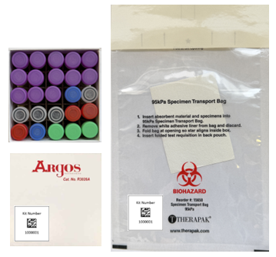
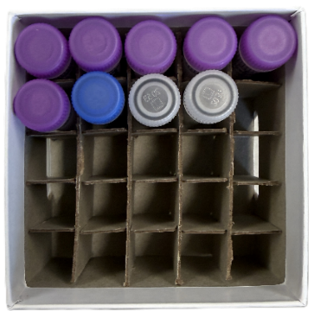
Frozen Batch Shipment Packaging
Batch shipping should be performed quarterly or when 8 cryoboxes of samples have been collected
*No more than 8 cryoboxes per batch frozen shipment*
Blood samples
Blood kit number labels

Slide 29
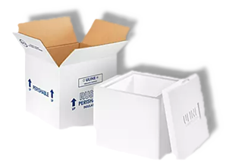
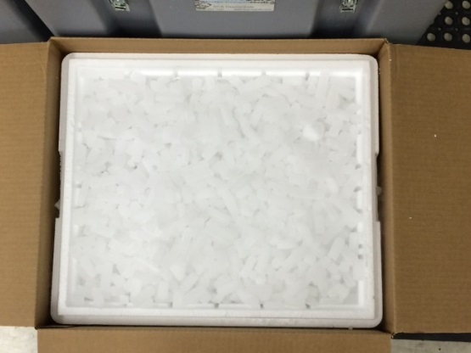
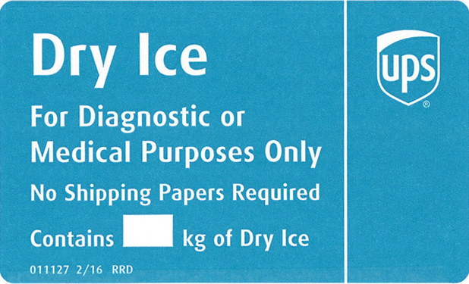
Frozen Batch Shipment: Dry Ice
Place 2-3 inches of pelleted dry ice in the bottom of the Styrofoam shipping container, then insert the cryoboxes laying upright.
Fully cover the cryoboxes with about 2 inches of pelleted dry ice.
Each Styrofoam shipper must contain 45 lbs (20 kg) of pelleted dry ice and this must be marked on a blue UPS dry ice sticker that is placed on the outside the box.
Net weight of dry ice in kg

Slide 30
Shipping with ShipExec
Using ShipExec to:
Creating Airbills
Scheduling Shipments and Pickups

Slide 31
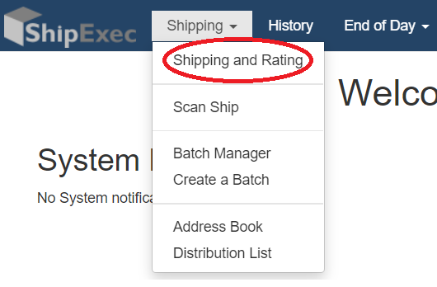
Logging into
ShipExec
Log in to ShipExec™ Thin Client: https://kits.iu.edu/ups
  If a new user or contact needs access, please reach out to me at jazdicki@iu.edu
Navigate to the ‘Shipping’ dropdown menu and select ‘Shipping and Rating’

Slide 32
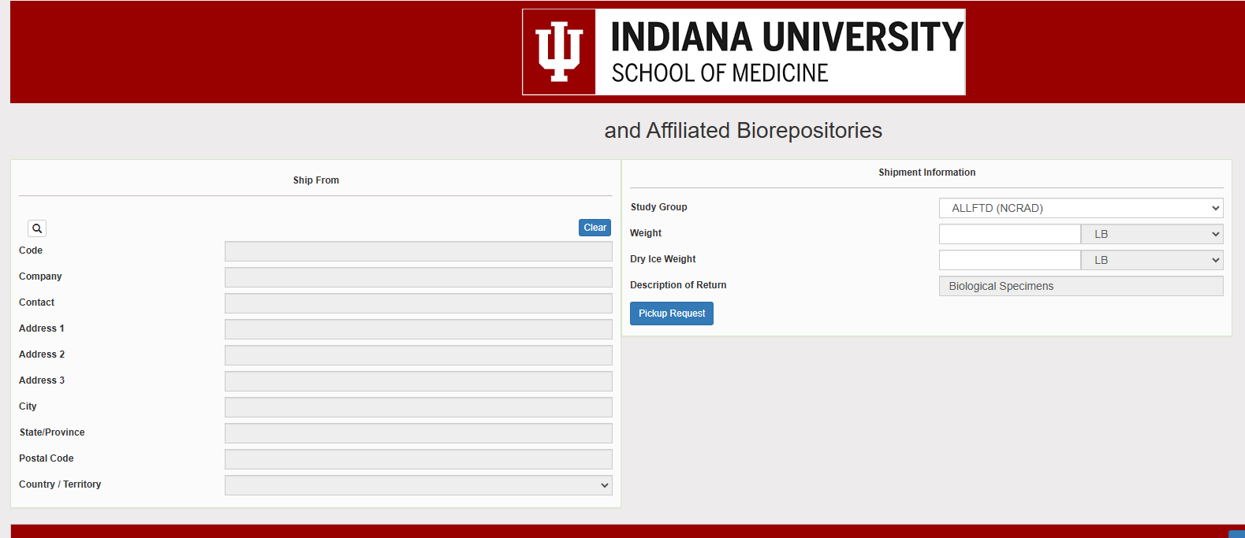
Select your study
On the right of the page, choose the study name (SCI-PE) from the “Study Group” drop down.
  This must be done first
Then click on the Magnifying Glass on the left to begin searching for your contact information.
SCI-PE (NCRAD)

Slide 33
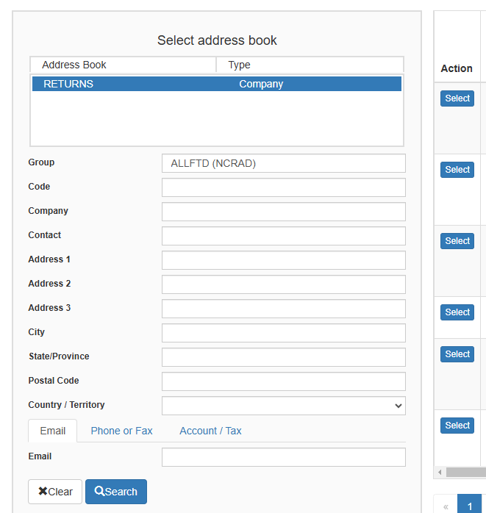

Find your site
A pop up will appear with a list of all the site addresses within the study selected, please choose your site
  For further filtering results enter and search:
    “Company”
    “Contact”
    “Address 1”
Once you have found your site address, click on the “Select” button to the left of the address
Note: Ensure this information is accurate. If any information needs
to be updated, contact your NCRAD study coordinator: jazdicki@iu.edu

Slide 34
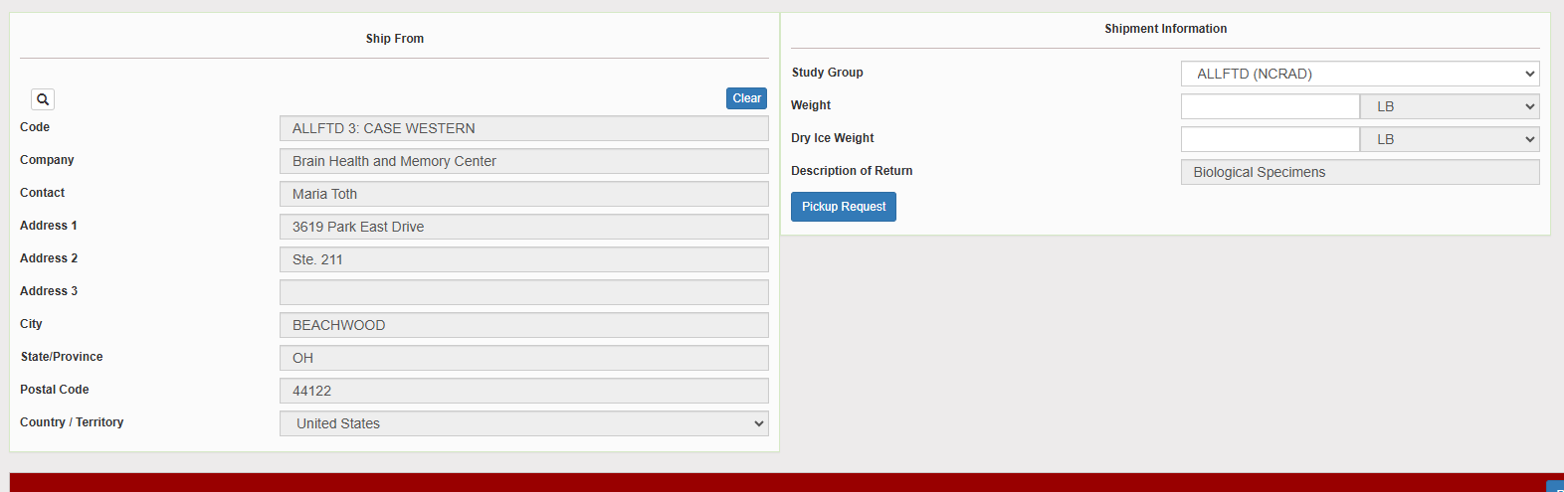
Shipment Info
Verify the address populated on the left is correct
Enter the total weight, including dry ice if needed, of your package in the “Weight” field
Enter the weight of the dry ice for frozen shipments in the “Dry Ice Weight” field
  The “Dry Ice Weight” field can never be higher than the “Weight” field
Click on the “Pickup Request” button
SCI-PE (NCRAD)
3: SCI-PE CASE WESTERN
For ambient shipments, leave the “Dry Ice Weight” field empty

Slide 35
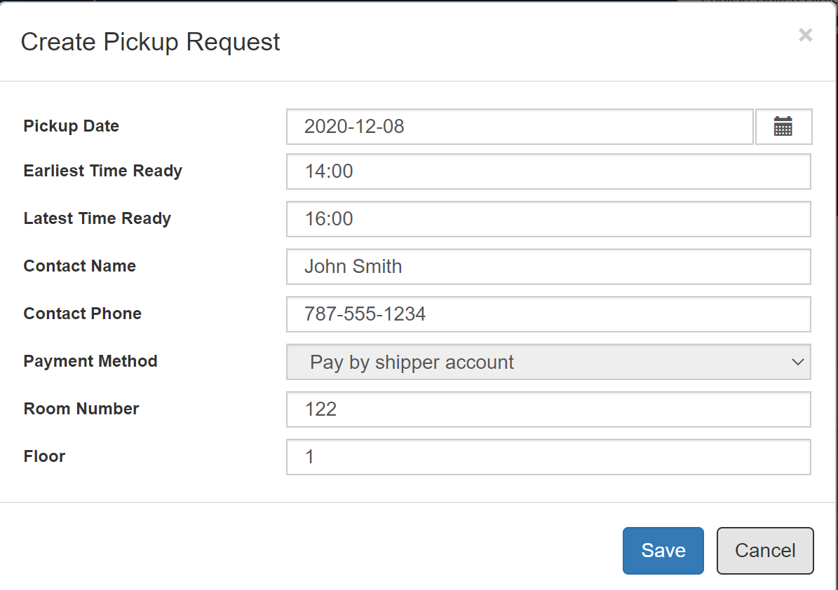
Pickup Request
Fill out all fields for the pickup request
Enter in the “Earliest Time Ready” and “Latest Time Ready” in 24-hour format
  Users must schedule pickup minimum 1 hour before “Earliest Time Ready”
Choose a name and number that is the best to contact if the UPS driver has questions related to picking up your package
Entering the Room Number and Floor will help the UPS driver locate your package
  Room number field is free text, Floor field is numerical only
Hit “Save” when done

Slide 36
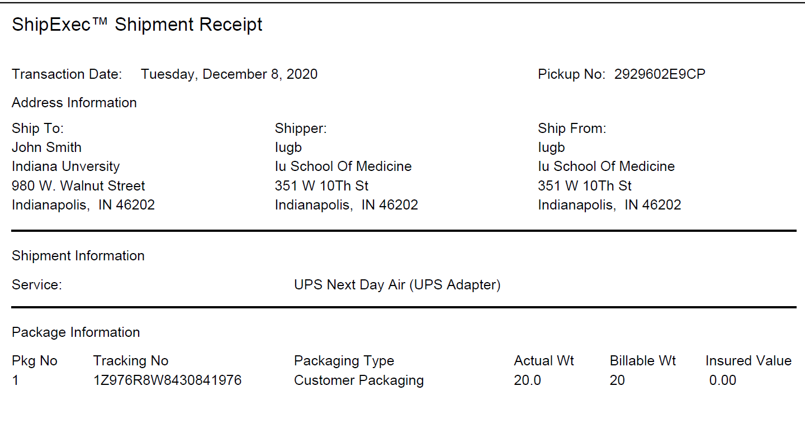
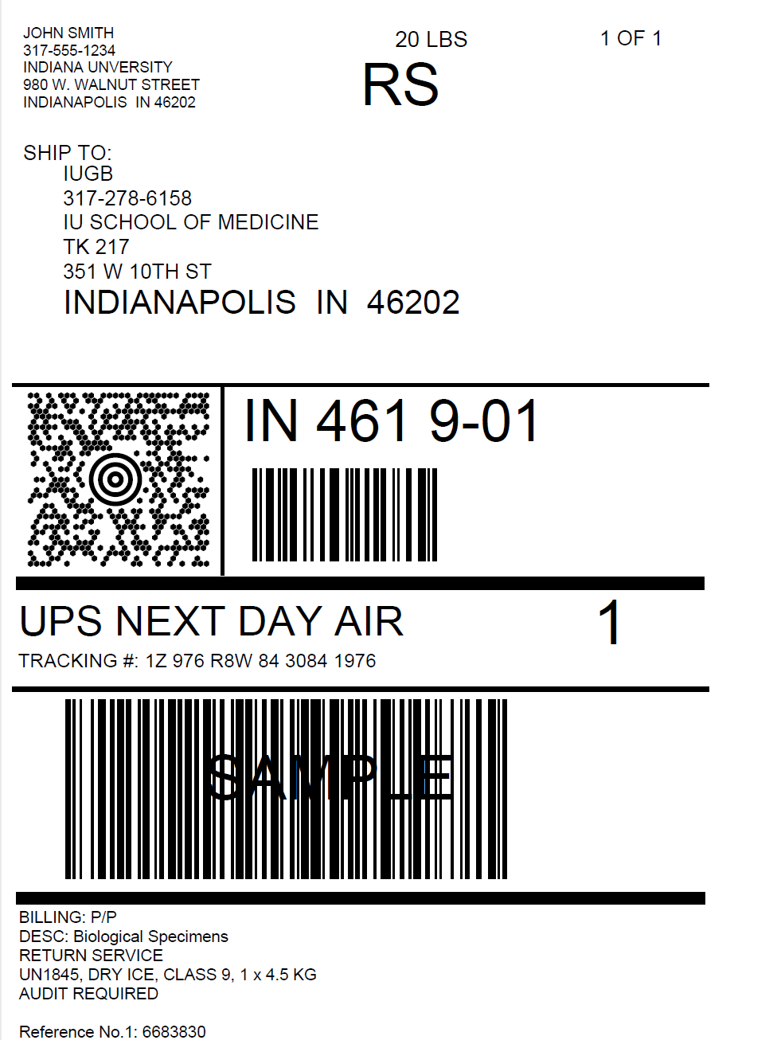
Shipment Paperwork
Two documents will be created and will need saved:
  Receipt
  Waybill
The “Pickup No:” is the reference number to your specific pickup request, this is the number you use if there are issues
Check Pickup Status by going to UPS.com, click on the Shipping, select Schedule a Pickup, and look on the right side of screen to click on “Pickup Request Status”. Enter in the Pickup No. listed on receipt into PRN field and submit

Slide 37
UPS Waybill
Print out the UPS air waybill
Fold the UPS air waybill and slide it inside the plastic UPS sleeve provided
Adhere to the sleeve to your package, making sure it is laying as flat as possible along the surface of the package with the barcode readable

Slide 38
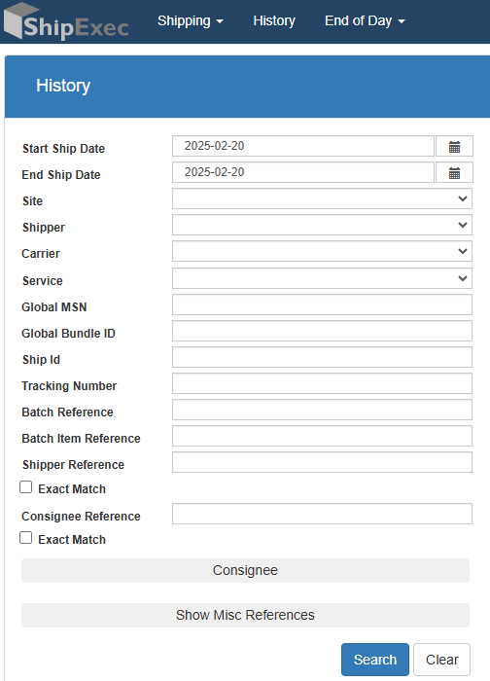
Voiding or Reprinting
If you need to void your shipment or reprint your air waybill, click on “History” at the top of the ShipExec™ Thin Client page
  Search for the desired shipment by date of shipment

Slide 39
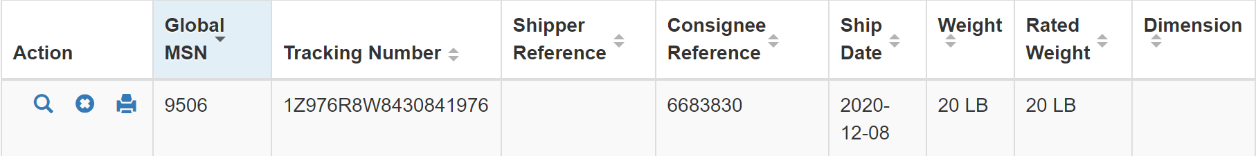
Voiding or Reprinting
To void your package, click on the “X” icon to the far left under “Action”
To reprint your waybill, click on the printer icon to the far left under “Action”

Slide 40
Advanced Notification
IMPORTANT
The NCRAD Sample Shipment Notification Survey must be filled out prior to shipment
  Please attach the completed Sample and Processing Form for each set of samples within the shipment
  Please fill out the entire survey including contact and tracking information
This is extremely important to make sure samples are:
  received on time to the NCRAD lab
  correctly labeled and organized per patient
  completed and ready for data entry

Slide 41
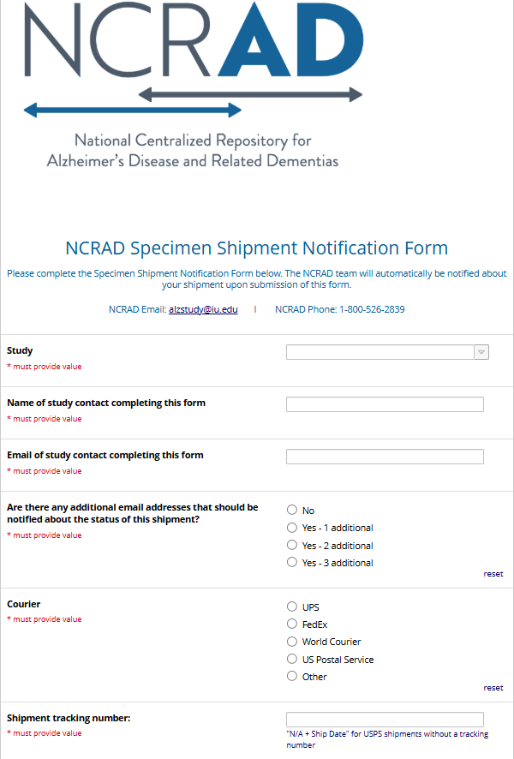
NCRAD Sample
Shipment Notification
1. Ship samples as normal using ShipExec and place the Printable CRFs (from previous slide) in the shipper
2. Go to link:
https://redcap.link/NCRADShippingForm
3. Fill out and Submit Survey

Slide 42
NCRAD Website – SCI-PE Page
Specimen collection overview
Link to kit request module
Online Sample Survey
MOP
Training Slides
Video Tutorials
UPS Shipping/Shipping Survey
https://ncrad.org/coordinate-studies/SCI-PE

Slide 43
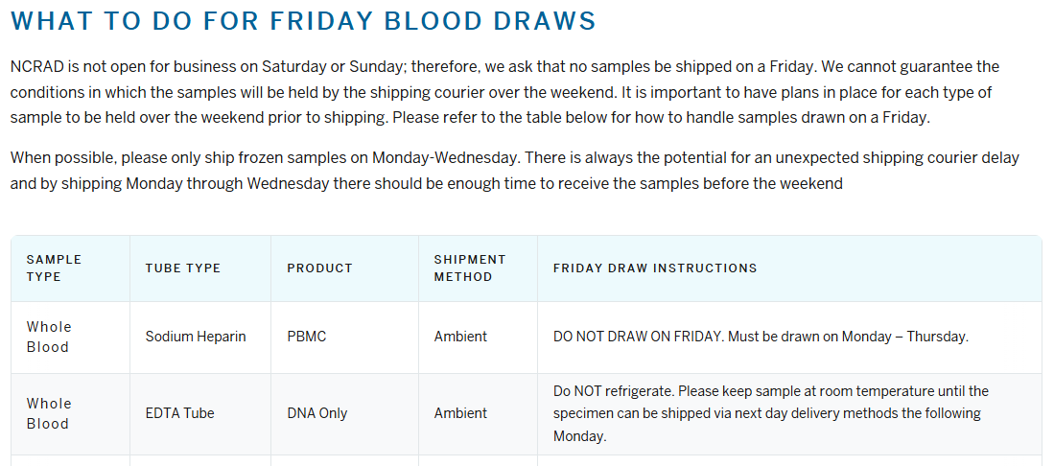
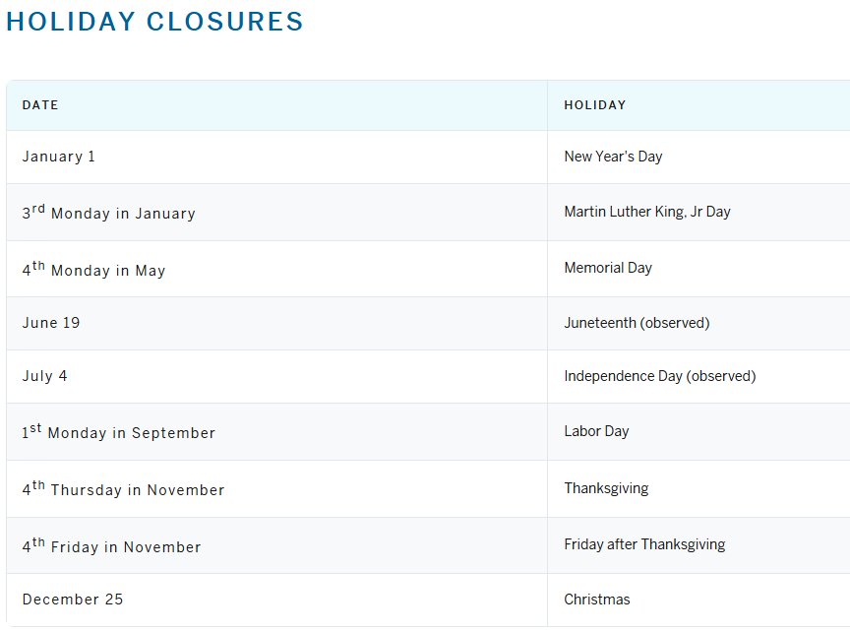
NCRAD Website – Helpful Pages
https://ncrad.org/contact/holiday-closures
https://ncrad.org/contact/friday-blood-draws

Slide 44
FAQ
Q: Can the online Sample and Processing Survey be partially completed and finished later by another user or at a later time?
  A:Yes. If multiple staff members need to enter information, the first person can complete part of the form (including the required fields needed to return later: staff email address, Participant ID, and Kit Number), then select “Save and Return Later.”
    The email address(es) entered will receive a link along with the access codes (Participant ID and Kit Number) needed to reopen the form.
Q: What should I do with expired supplies, should I send them back?
  A: You do not need to send them back, please dispose of them according to your local guidelines.

Slide 45

SCI-PE Contact Information
General Information
  Phone: 1-800-526-2839
  or 317-278-8413
  E-mail: alzstudy@iu.edu
Jazmyn Dickinson – SCI-PE Study Coordinator
E-mail: jazdicki@iu.edu
Corinne Kim - Project Manager
E-mail: kimcor@iu.edu

